Slide 1
Submillimeter-Wave Phased Arrays for Electronic Beam Scanning
2020 Postdoc Research Day Presentation Conference
Subash Khanal
Organization: 386H
Advisor: Dr. Goutam Chattopadhyay (386H)
Postdoc Program: NPP
Acknowledgement: Sofia Rahiminejad (389R), Cecile Jung-Kubiak (389R), Sven van Berkel (386H)

Slide 2
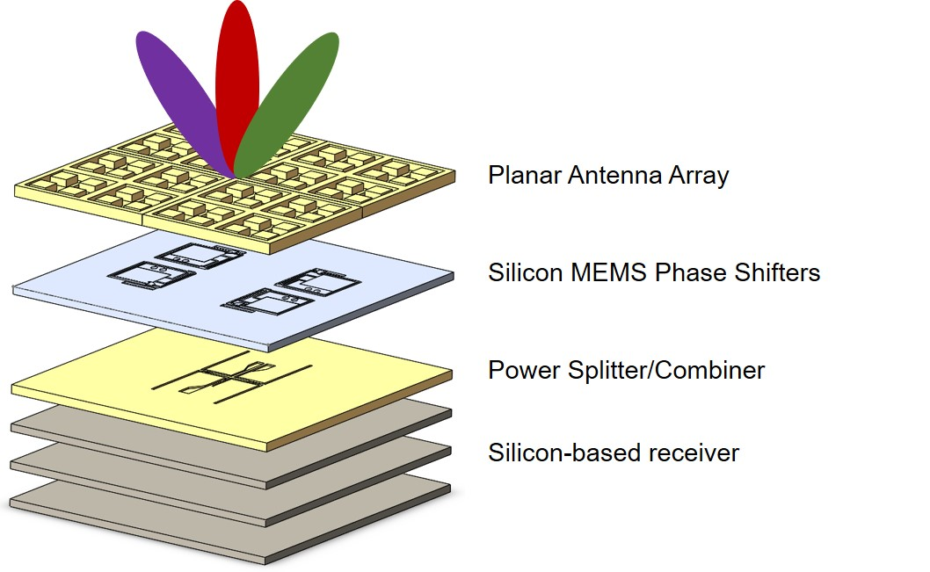
Introduction
Abstract
Development of sub-millimeter wave MEMS-based phased array planar antenna
Electronic beam steering capability for submillimeter-wave instruments for planetary science applications.
Antenna frequency band from 500-600 GHz → important for measurement of planetary and cometary atmospheres trace gas and water isotope
Tunable MEMS phase shifters → phase of each antenna element → electronic beam steering.
Low power consumption and compact size → possibility for implementation on CubeSat platform
MEMS: Micro-electromechanical system

Slide 3
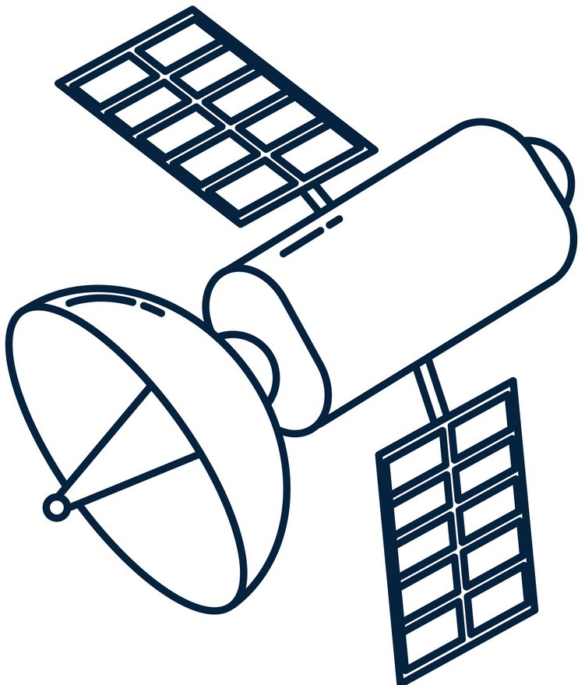
Problem Description- Mapping of cold bodies
At submillimeter frequencies > 300 GHz
Current state-of-art system where mapping is done with mechanical scanning or re-orientation of the spacecraft
Electronic beam steering enables mapping without physical movement of the space craft or the receiver
Disadvantages: High power requirement and heavy structures → expensive and bulky
Advantages: Fast mapping, reduced mass and power consumption → low cost and compact size suitable for CubeSat platform

Slide 4
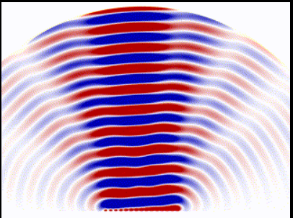
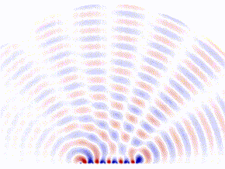
Methodology: Phased Array
Normal Antenna array
Phased array
Phase shifters

Slide 5
Methodology: MEMS-based phased array concept
Highlights:
Electronic beam steering using MEMS-phase shifters at each feed.
Planar topology using silicon micromachining.
Compact, light weight and low power consumption system for planetary and astrophysics applications
Innovation:
First ever electronic beam scanning system at these frequencies (500-600 GHz)

Slide 6
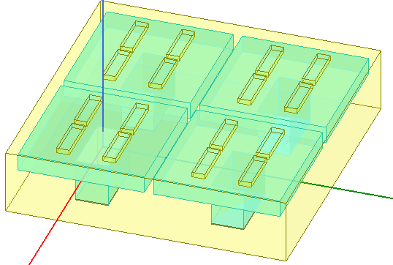
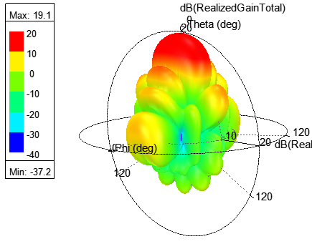
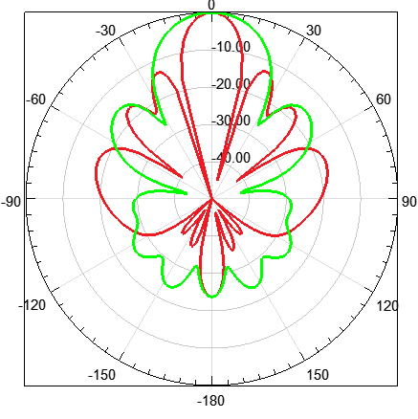
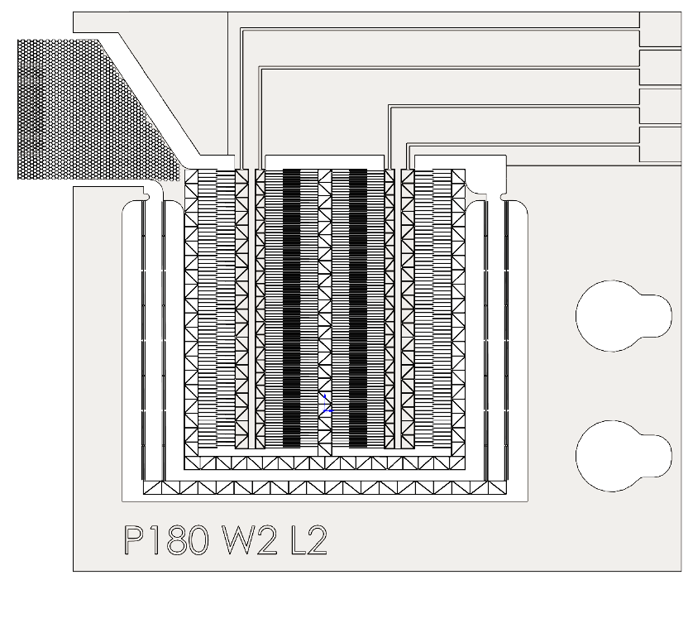
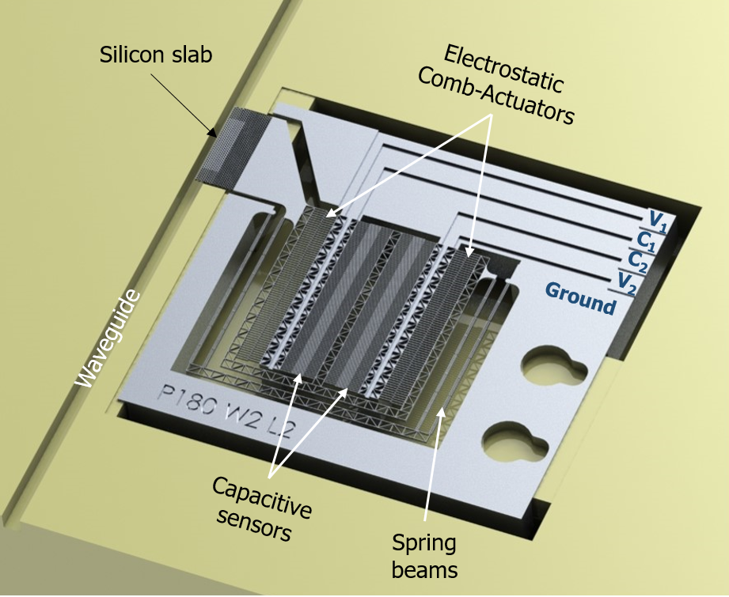
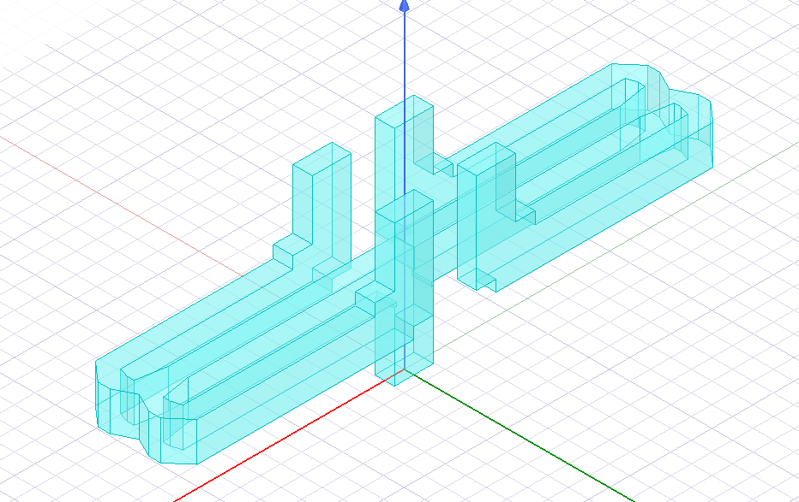
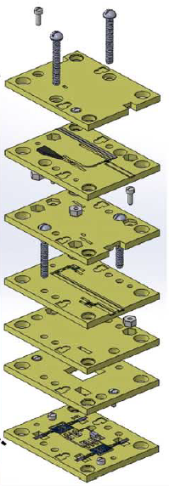
Antenna Array
Desired performance: Beam steering : $±$ 20 deg, frequency bandwidth: 500 to 600 GHz (18 %), side lobe level < -15 dB
2×2 Array Feed Network
2×2 Cavity backed slot antenna array
Sim. Gain = 19 dB, SLL = -13 dB
MEMS Phase Shifter
Max. Phase Shift = 145 degrees
MEMS-phase shifter designed by Dr. Sofia Rahiminejad (389R)
Silicon based receiver layers

Slide 7
Results
Accomplishments versus goals
MEMS phase shifters have been developed and maximum of 145 degrees phase shifts is achieved.
Antenna array design work is ongoing.
2×2 Array design : 19 dB gain and -13 dB side lobe level has been achieved (simulation)
Design options are being explored to meet the target of 20 degrees beam steering.
Significance
First ever electronic beam scanning system at these frequencies. This will open a novel type of systems for Astrophysics and Planetary applications.
Next steps
Antenna array design iteration and optimization to meet the beam scanning requirement.
MEMS phase shifter design improvement to increase phase shift
System integration for larger array size (for example 16×16 or 32×32).

Slide 8
THANK YOU

