Slide 1
The Effects of Methane Clathrates on Ice Shell Structure
Image Credit:
A. D. Fortes/UCL/STFC
2020 Postdoc Research Day Presentation Conference
Angela G Marusiak
Organization: 3226 Planetary Interiors and Geophysics
Advisor: Steven Vance and Mark Panning (3226)
Postdoc Program: JPL

Slide 2
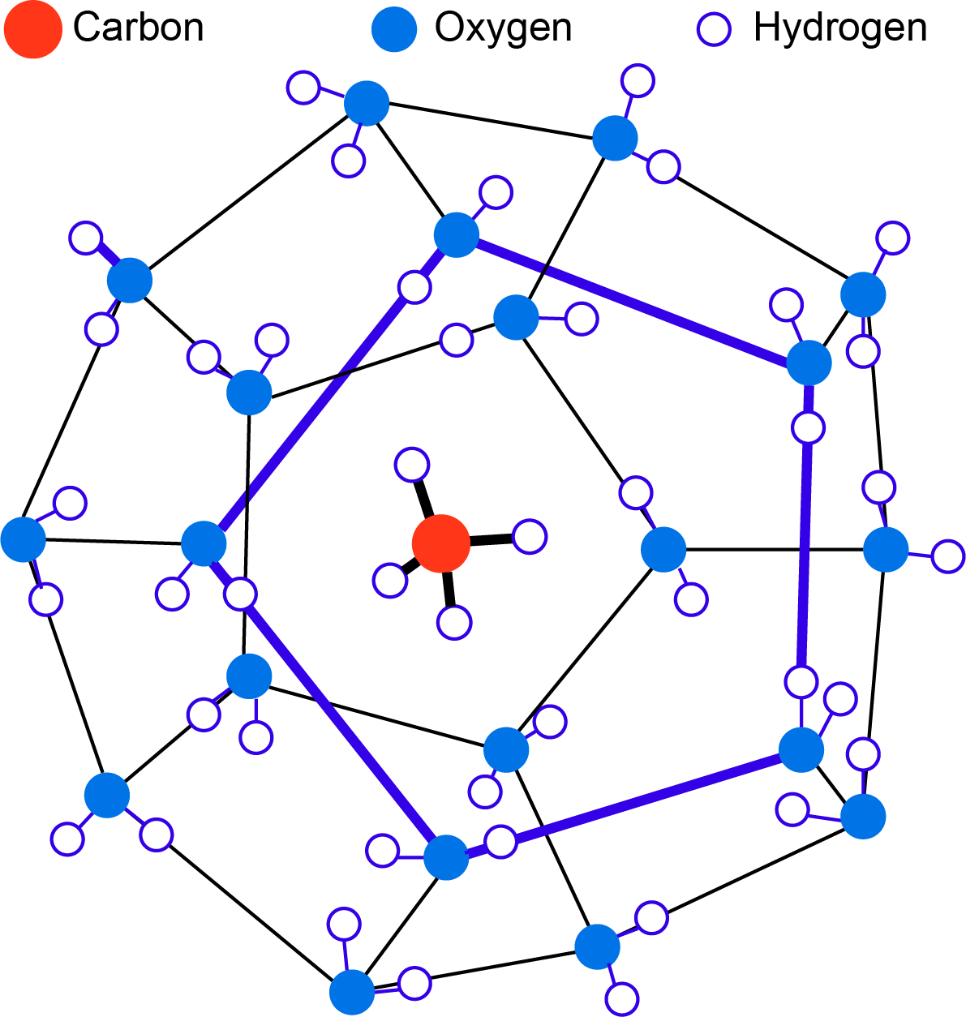
Introduction
Abstract
Methane clathrates are likely present in Titan’s interior and could play a vital role in Titan’s methane cycle.
Dragonfly, a recently selected Discovery class mission, will explore Titan’s surface.
Dragonfly will also carry a seismic payload package.
Here, I investigate if clathrates, and their effects on thermal and seismic profiles, can be detected by a seismometer.

Slide 3
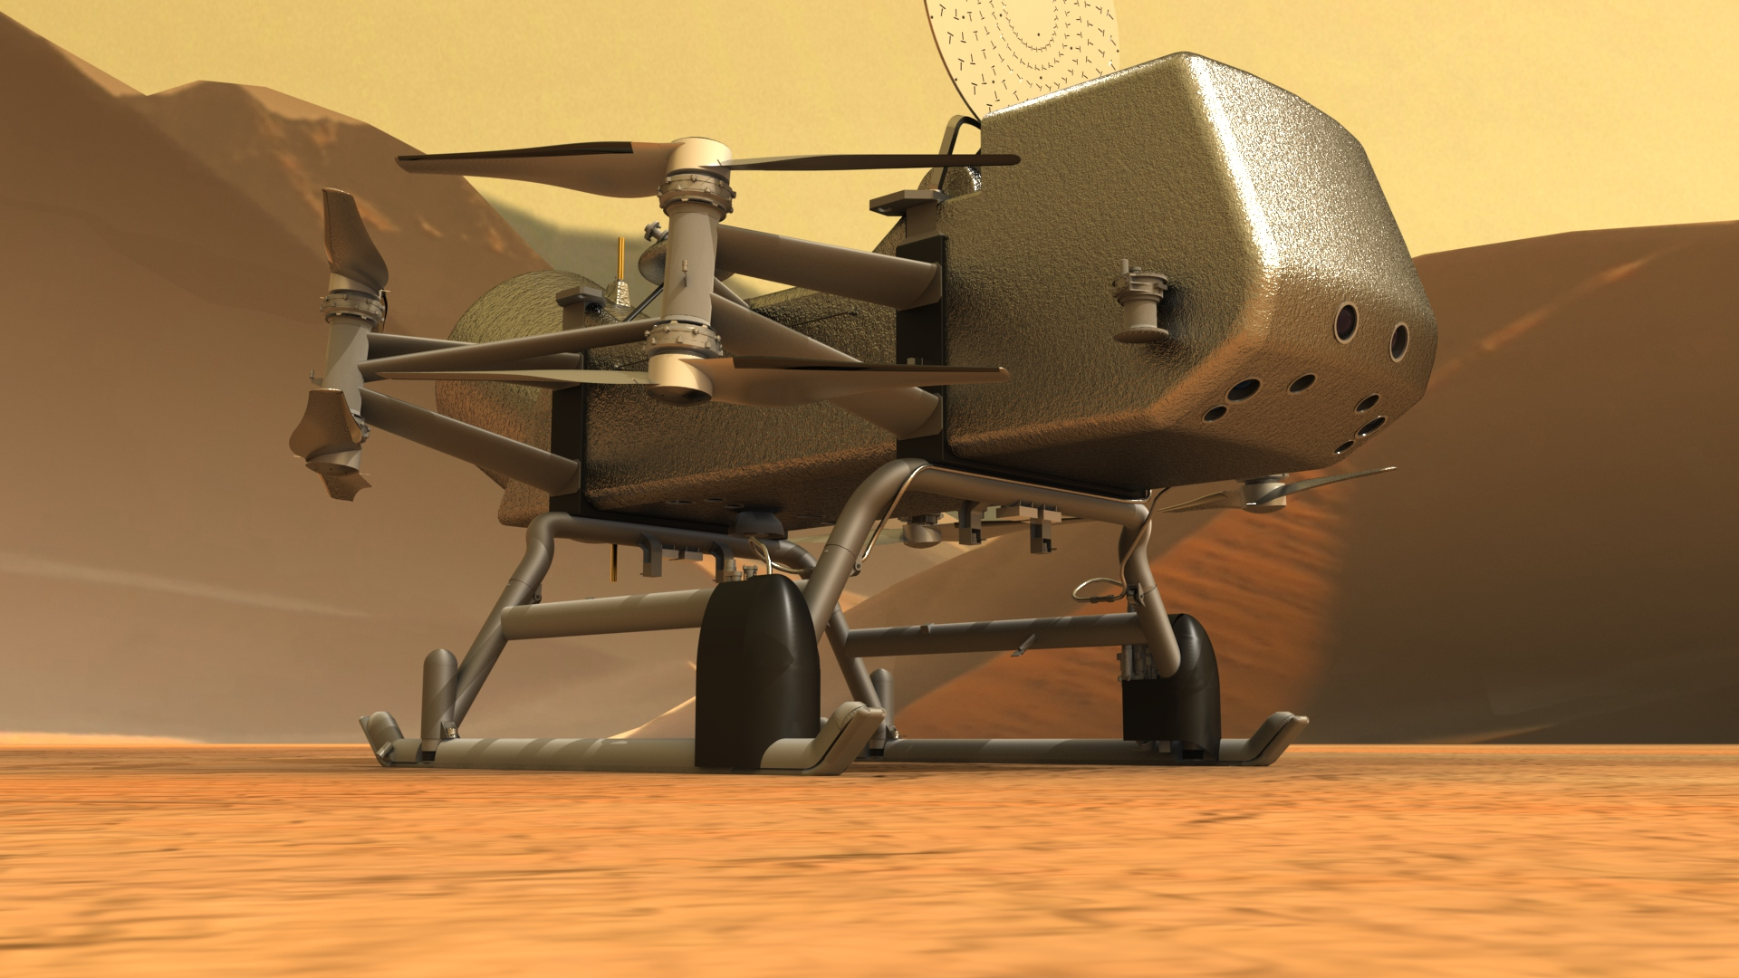
Problem Description
1) How do clathrates affect the structure of Titan’s ice shell?
Are there changes in density, physical properties, etc that alter large scale structure?
2) Can seismometers detect these changes?
Are seismic properties altered significantly?
Image Credit: JHU APL

Slide 4
Methodology
1) Use updated experimental data (SeaFreeze) and literature values to determine chemical influence on physical structure
2) Update PlanetProfile to create geophysically self-consistent models with clathrates and water ice
3) Compare seismic velocity structure and waveforms

Slide 5
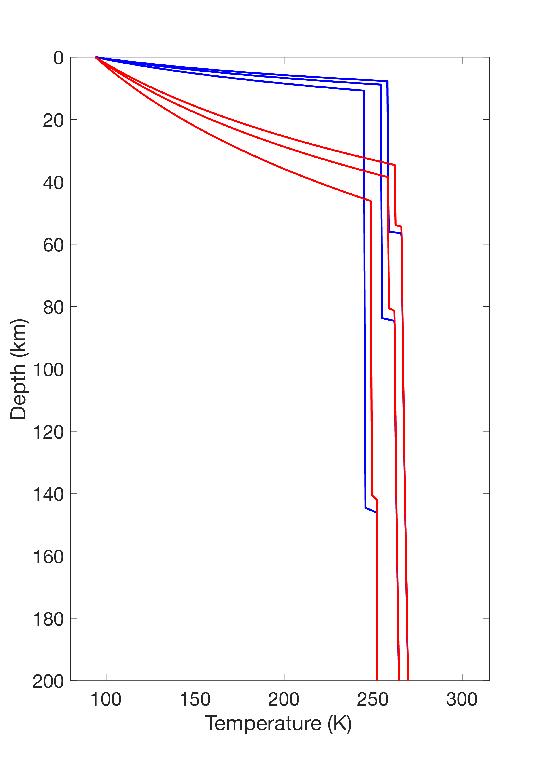
Results
Clathrates (red) increase conductive lid thickness compared to pure water ice (blue), can create slight reduction in overall ice shell thickness

Slide 6
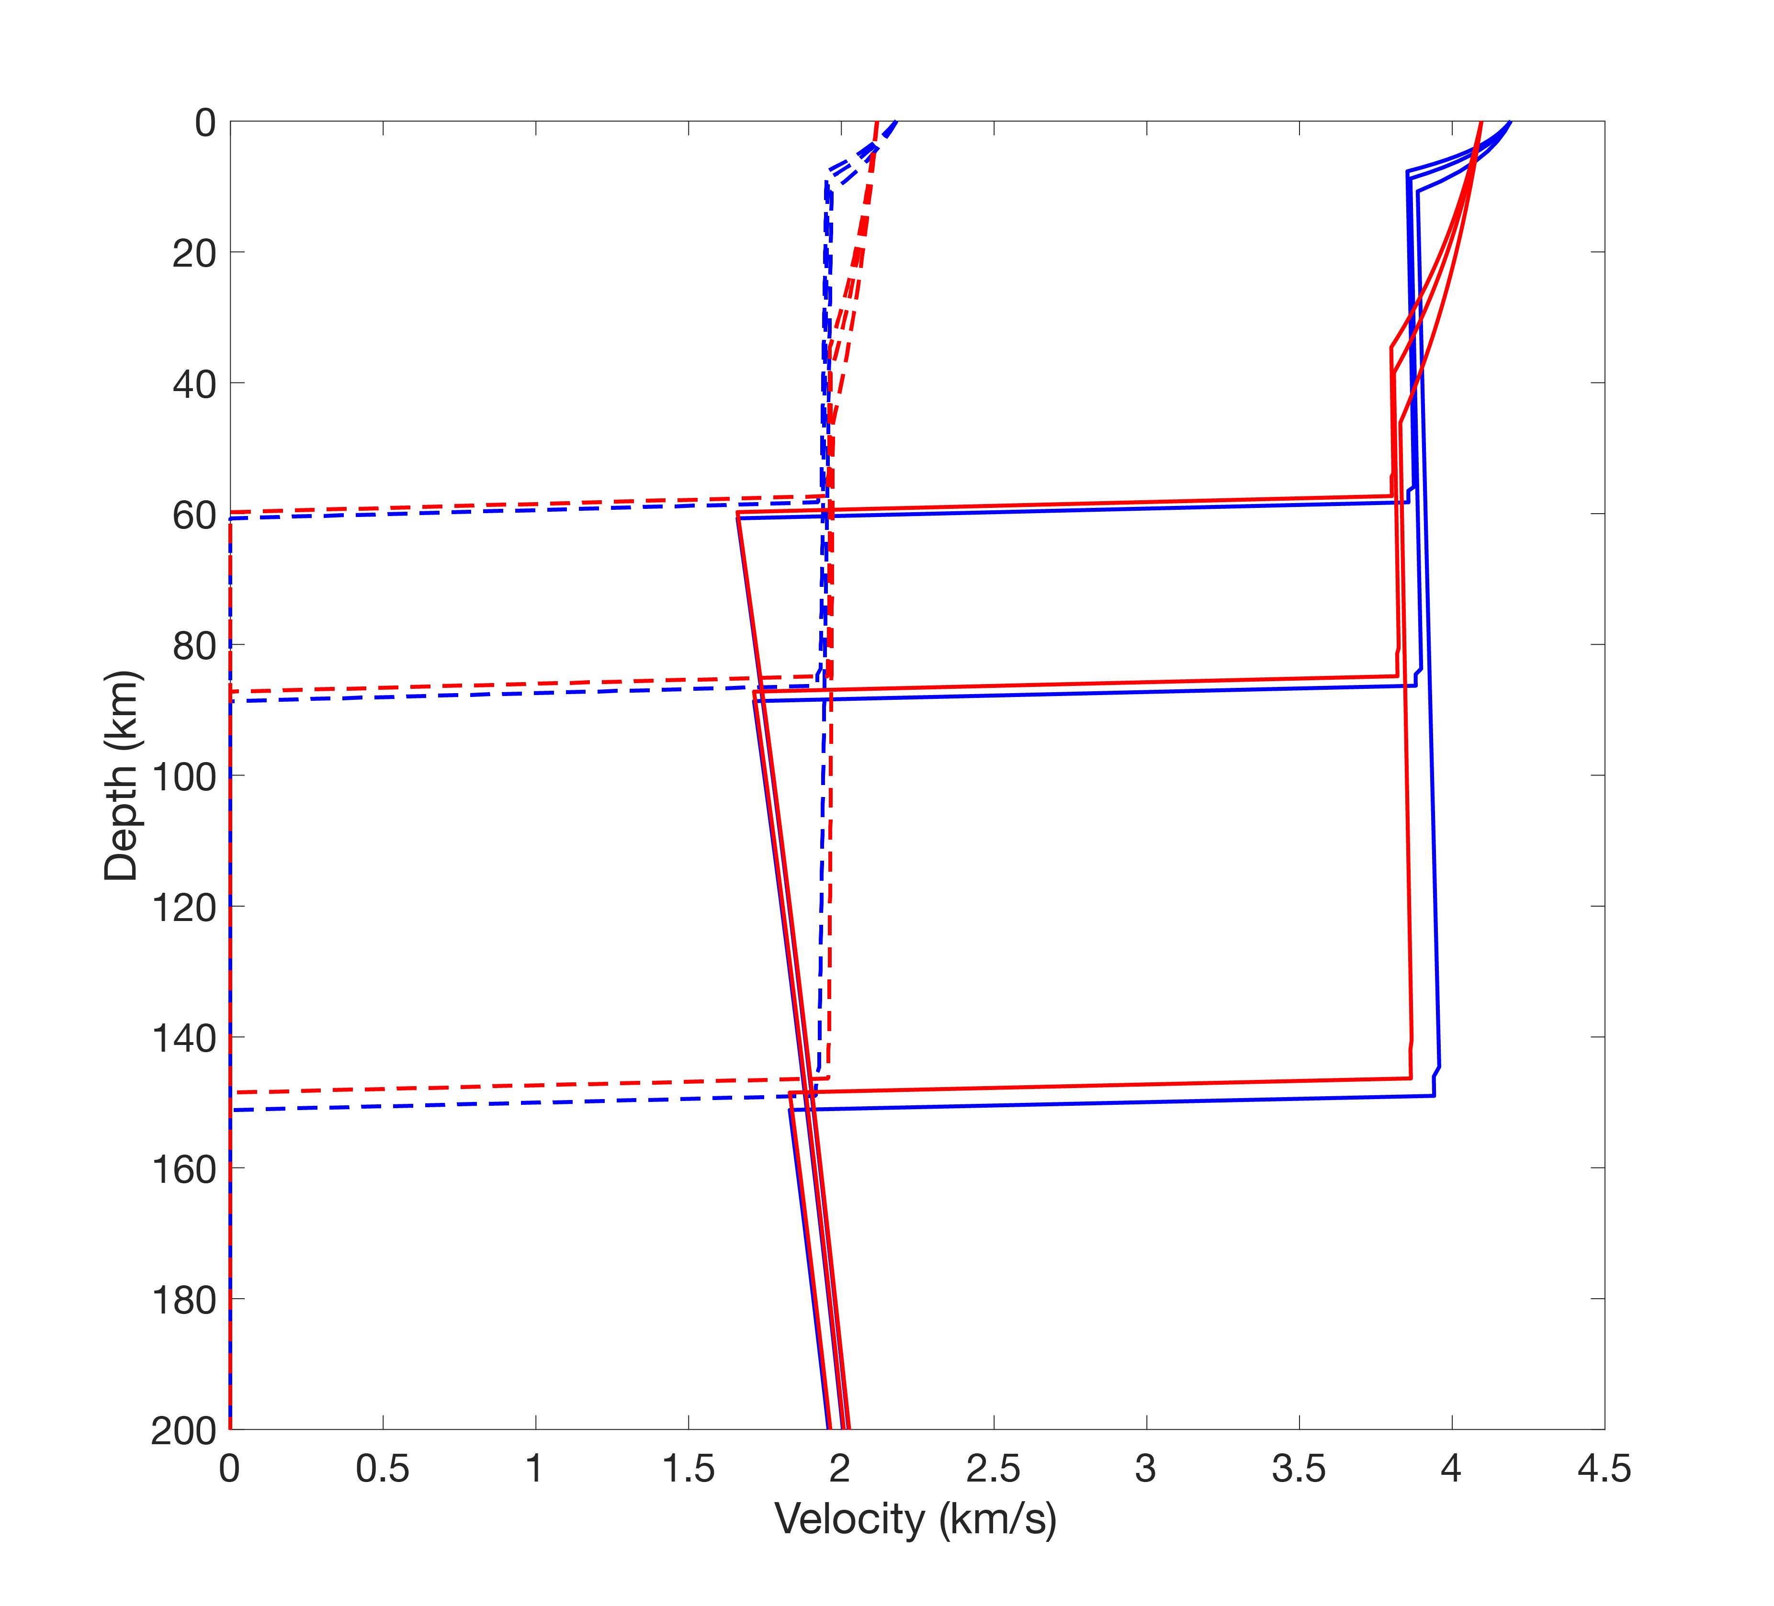
Results
Clathrates (red) increase conductive lid thickness compared to pure water ice (blue), can create slight reduction in overall ice shell thickness
Change in Temperature→ Change in Seismic Velocity (V_{P} Solid, V_{S} dashed)

Slide 7
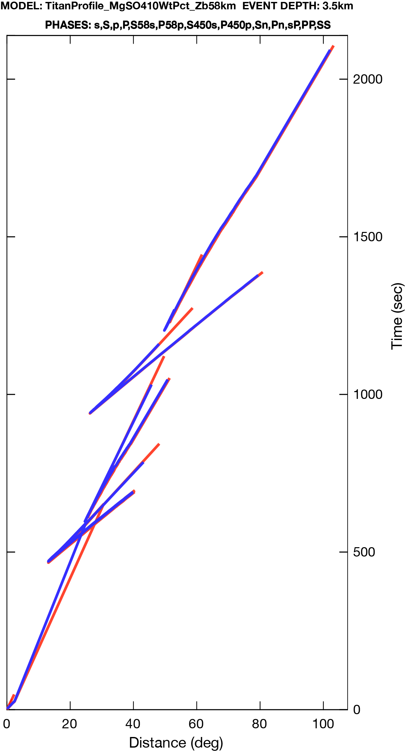
Results
Clathrates increase conductive lid thickness, can create slight reduction in overall ice shell thickness
Change in Temperature→ Change in Seismic Velocity
Change in Seismic Velocity→ Change in arrival times and observable distances (example using ice shell ~60 km thick)

Slide 8
Results
Clathrates increase conductive lid thickness, can create slight reduction in overall ice shell thickness
Change in Temperature→ Change in Seismic Velocity
Change in Seismic Velocity→ Change in arrival times and observable distances (example using ice shell ~60 km thick)
Clathrates will significantly change the thermal and seismic structure of an icy ocean world
Could be detectable through seismology

Slide 9
Publications and Acknowledgements
Work is still ongoing. Any updates will be presented virtually at AGU in December
Thank you to my mentors: Mark Panning and Steve Vance
Special thanks to: Baptiste Journaux, Evan Carnahan, Sai Tharimena
Funding Sources: Vital Signs Project, Habitable Words Grant #:16-HW16-2-0065

