Slide 1
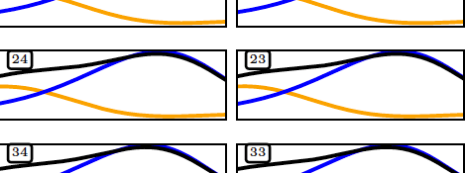

X-cut Cosmic Shear
Peter L. Taylor
Organization: 3268
Advisor: Jason Rhodes (3200)
Postdoc Program: NPP

Slide 2
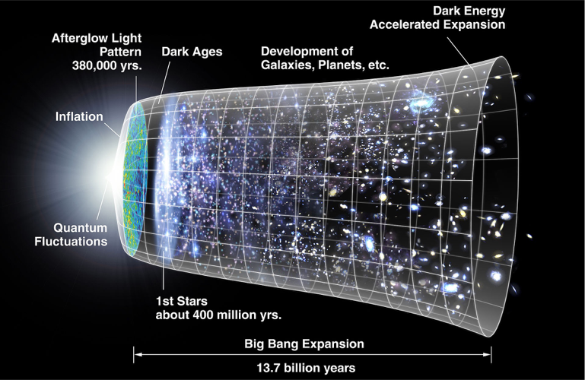
Accelerated Expansion
Credit: WMAP Collaboration

Slide 3
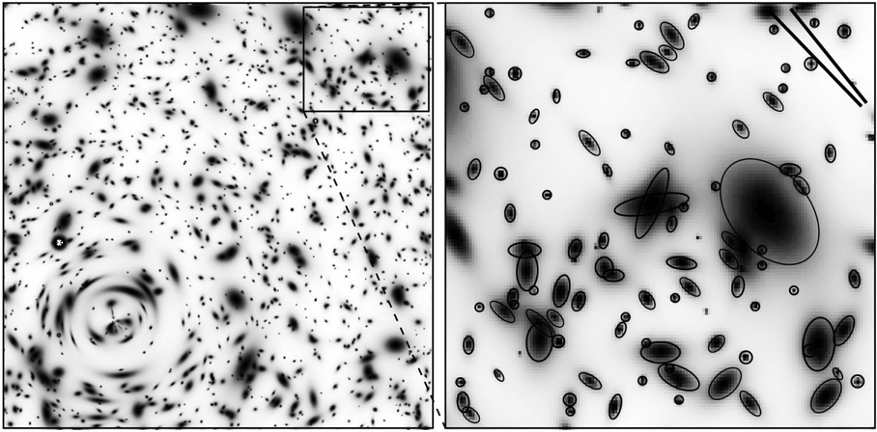
Weak Lensing
https://ned.ipac.caltech.edu/level5/March03/Mellier/Mellier2.html

Slide 4
Problem
We don’t understand structure growth at small scales
Physical scales at different distances mixes into the same angular scales

Slide 5
Methodology

Slide 6
Results

Slide 7
Publications and Acknowledgements
Paper: Peter L. Taylor, Francis Bernardeau, Eric Huff. x-cut Cosmic Shear: Optimally Removing Sensitivity to Baryonic and Nonlinear Physics with an Application to the Dark Energy Survey Year 1 Shear Data. arXiv preprint arXiv:2007.00675, 2020. (submitted)

