Slide 1
The Radio and Microwave Sky as seen by Juno on Her Cruise Mission to Jupiter
2020 Postdoc Research Day Presentation Conference
Philippe Berger
Organization: 3266
Advisor: Tzu-Ching Chang (3266), with Shannon Brown, Olivier Doré, Steve Levin, Michael Seiffert
Postdoc Program: JPL Postdoctoral Scholar

Slide 2
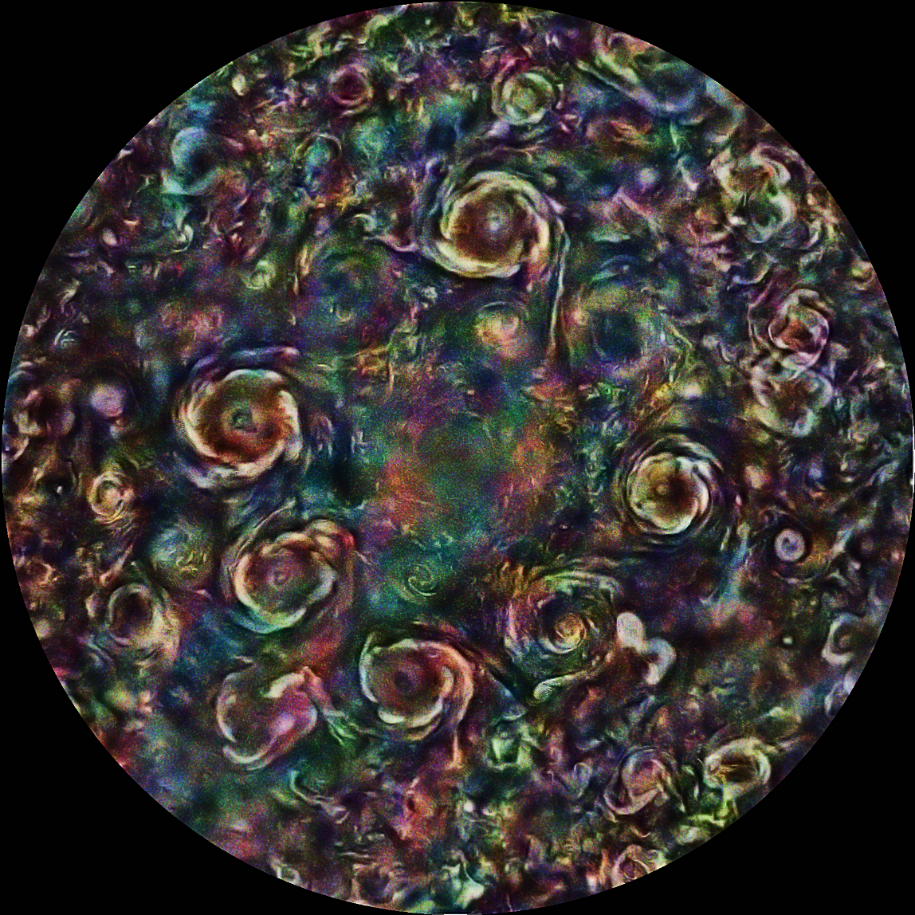
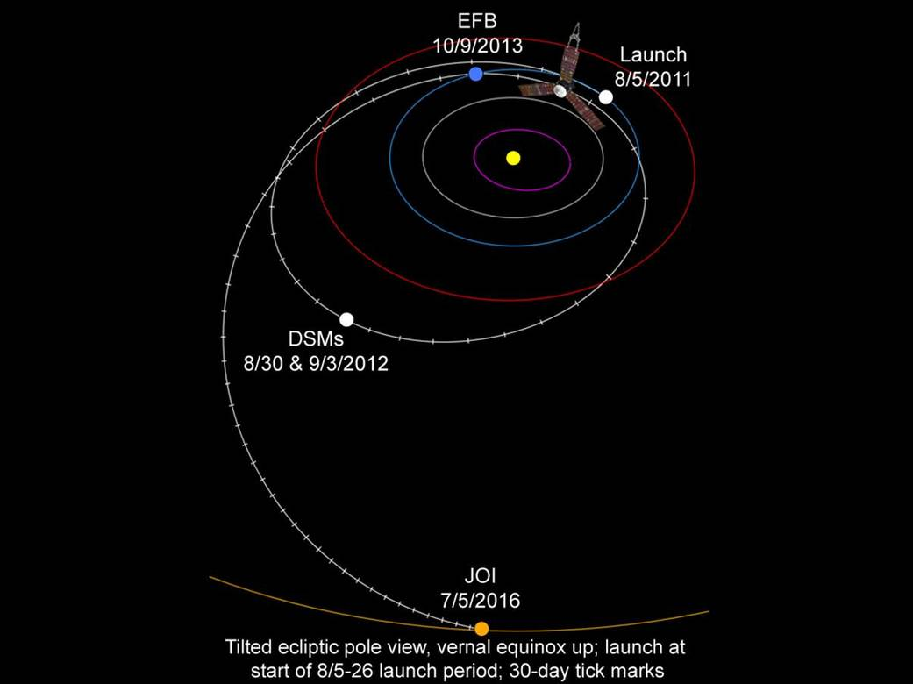
Juno’s Cruise Mission to Jupiter
[1]
[2]
False color optical image of Jupiter’s Northern Circumpolar Cyclones seen by JunoCam

Slide 3
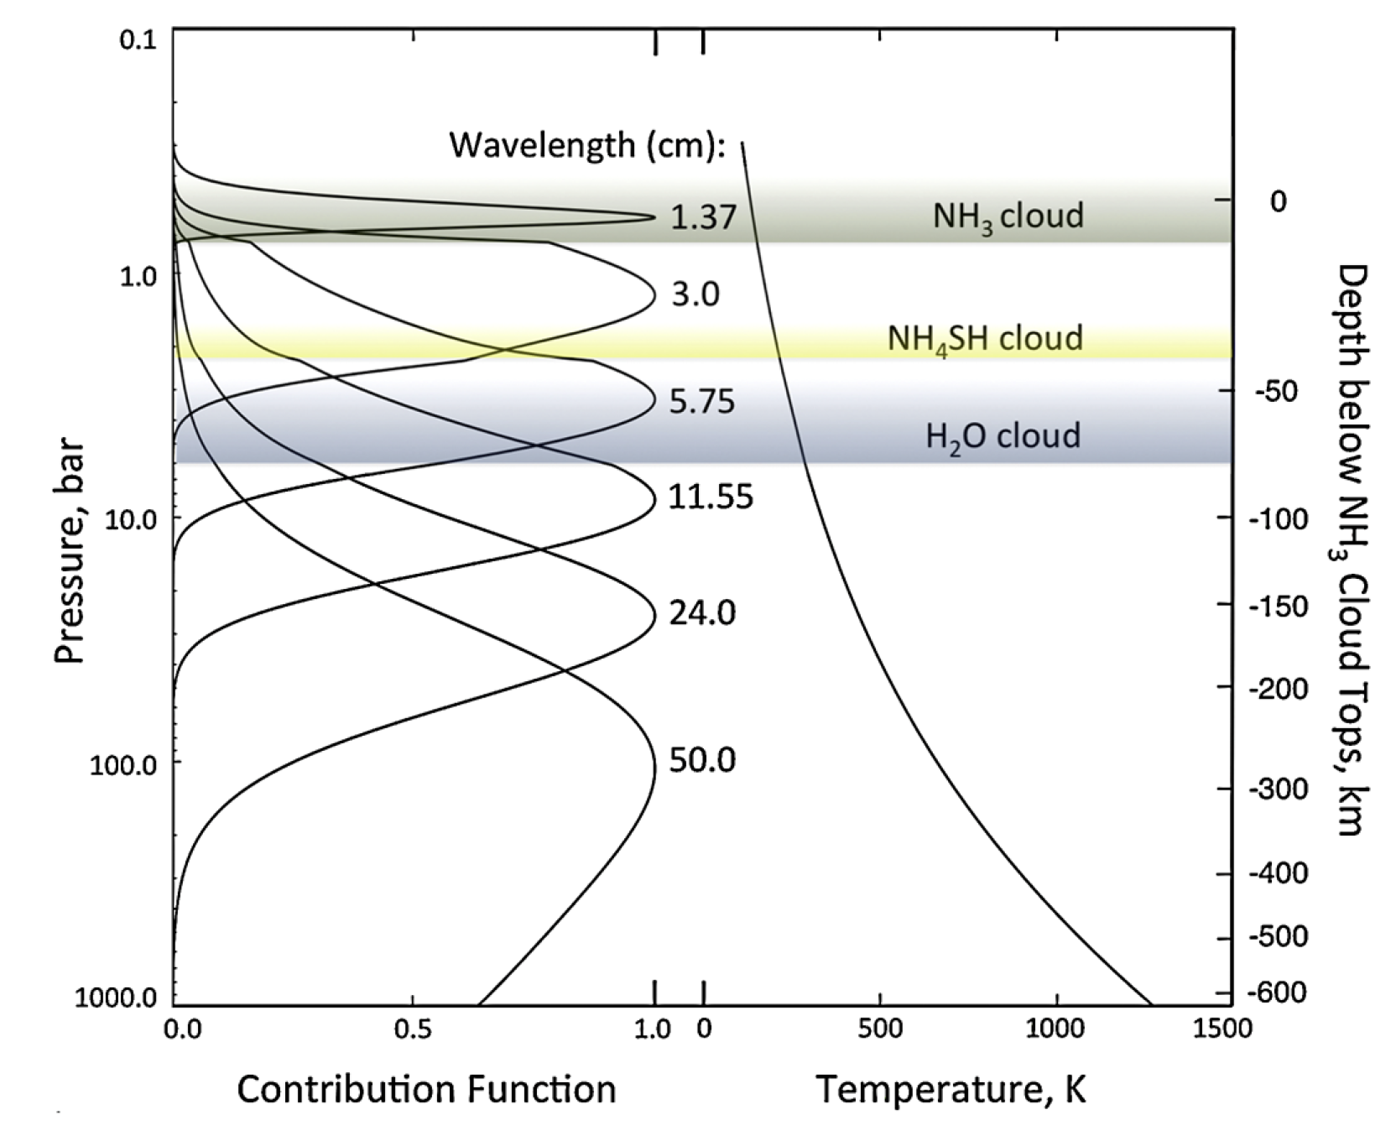
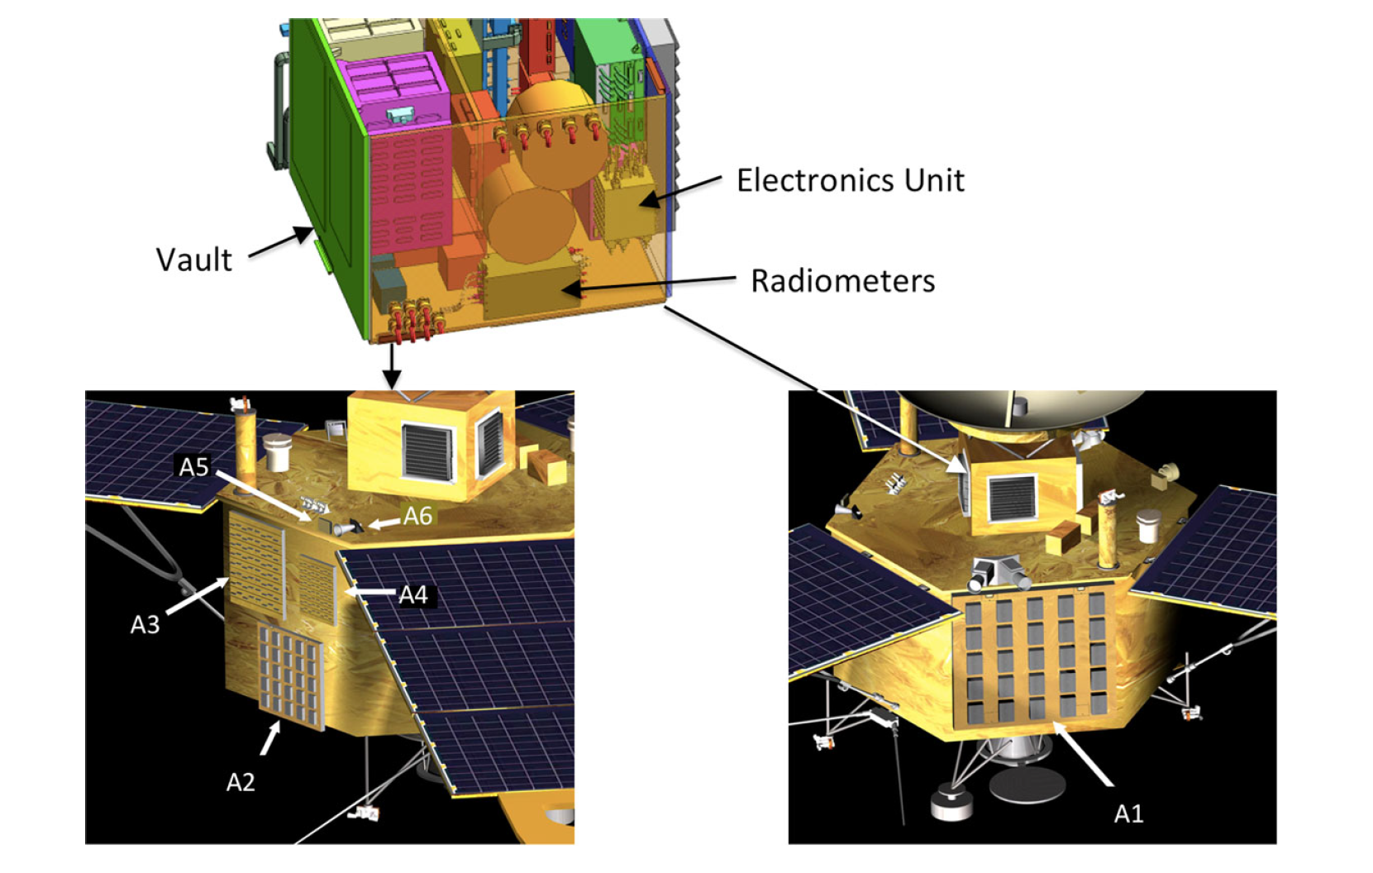
The Microwave Radiometer (MWR)
The 6 broad frequencies of Juno’s Microwave Radiometer are designed to observe deep in into Jupiter’s atmosphere.
Frequency [GHz] | Bandwidth [MHz] | Beam FWHM [°]
0.6 | 21.0 | 20.6
1.248 | 43.75 | 21.0
2.597 | 84.5 | 12.1
5.215 | 169 | 12.1
10.0 | 325 | 12.0
21.9 | 770 | 10.8
[3]
During Cruise, the MWR conducted a full sky survey at these frequencies.

Slide 4
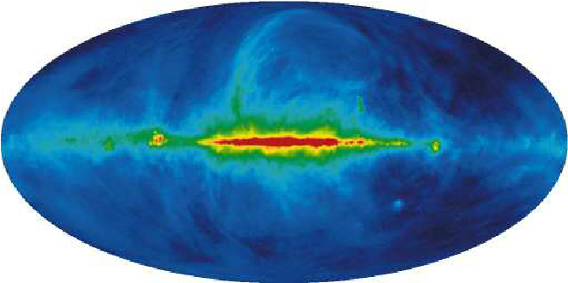
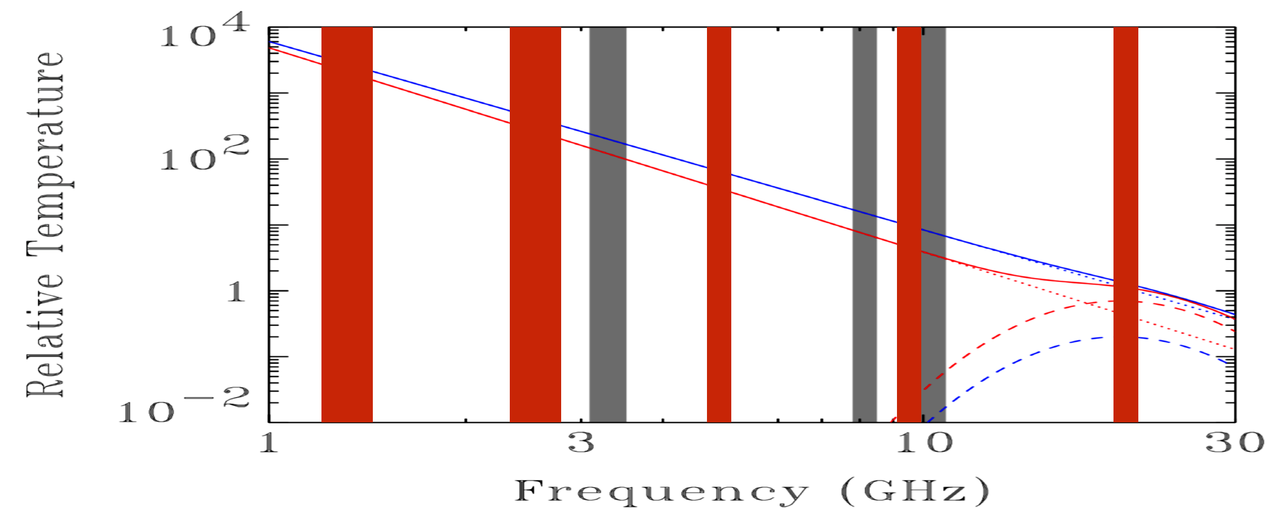
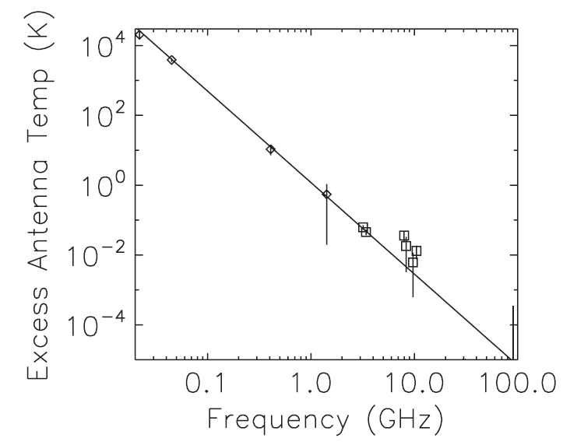
MWR Cruise - Science drivers
Improve models of Galactic emission on large angular scales
Characterize Anomalous Microwave Emission
Investigate ARCADE-2 Excess (or Radio Synchrotron Background)
[4]
[5,6]

Slide 5
Photometric calibration
Selfcal (iterative destriper)
$$P_{tp}m_{p}$$
Flagging and Time Period defintion
ML mapmaker
$$k_{t}, b_{t}$$
Solving for the gains $k_{t}$, correlated noise $b_{t}$, and the true sky map $m_{p}$ simultaneously is a hard non-linear problem.
$$T′_{A}\left(\hat{n}, t\right)=K\left(t\right)T_{A}\left(\hat{n}\right)+T_{off}\left(t\right)$$
$$d_{t}=k_{t}P_{tp}m_{p}+b_{t}+n_{t}$$
$$m^{it}={\left({\left(kP\right)}^{T}N^{−1}\left(kP\right)\right)}^{−1}{\left(kP\right)}^{T}N^{−1}\left(d −b\right), k=k^{it−1}, b=b^{it−1}$$
$$b^{it}=d − k^{it−1}Pm^{it−1}$$
$$k^{it}=\frac{\left(d−b^{it−1}\right)}{Pm^{it−1}}$$
$$k_{0}=1$$
$$b_{0}=0$$

Slide 6
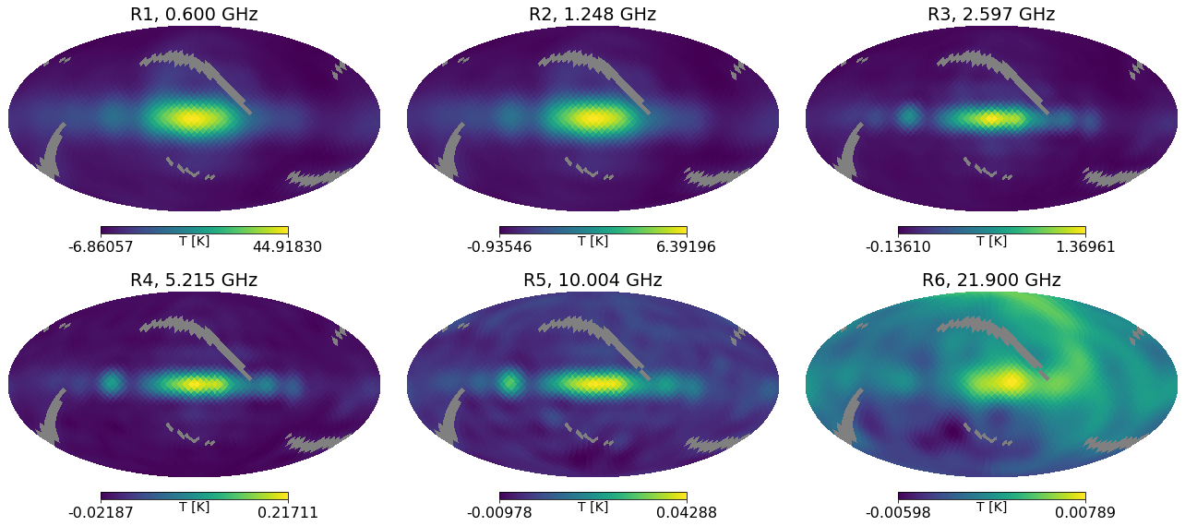
Maps and noise performance
Jackknife | R1 noise, mK | R2 noise, mK | R3 noise, mK | R4 noise, mK | R5 noise, mK | R6 noise, mK
Even-odd | 1.33 | 0.69 | 1.16 | 1.21 | 1.01 | 1.15
Pointing | 14.1 | 3.10 | 3.37 | 1.93 | 1.30 | 2.34

Slide 7
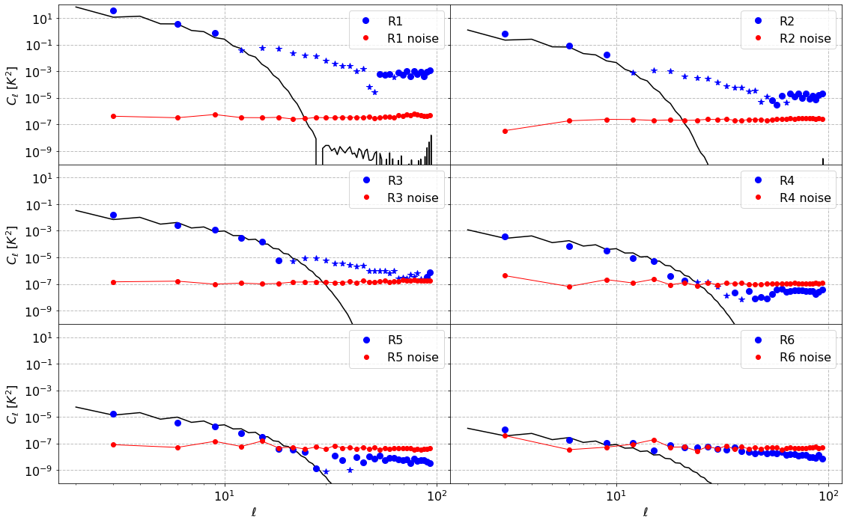
[7]
Comparison to the Global Sky Model
Frequency (GHz) | Relative gain [%]
0.6 | 0.39
1.2 | 11
2.6 | 3.7
5.2 | 24
10.0 | 25
21.9 | 3.8
Discrepancy at R4 and R5 could be due to spectral index fluctuations caused by spinning dust!
[8]

Slide 8
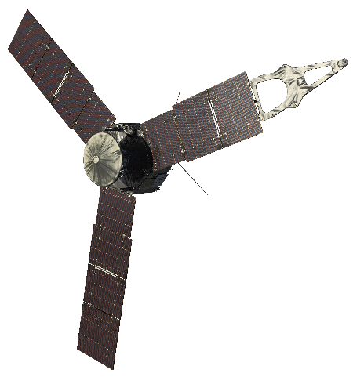
Conclusions and future work
The Juno MWR Cruise data provides a unique data set with unprecedented sensitivity to all-sky radio and microwave emission in a largely unexplored frequency range.
Implemented an iterative destriper which simultaneously solves for the instrumental parameters and sky temperature.
Currently conducting end-to-end simulations to validate and tune our photometric calibration algorithm.
Begun analyzing the output maps towards extracting information from our Milky Way and beyond.

Slide 9
References
[1] – https://www.missionjuno.swri.edu/junocam/processing
[2] – https://www.nasa.gov/mission_pages/juno/multimedia/Juno20110727-3.html
[3] – M. A. Janssen et al, Space Sci. Rev. (2017) 139-185
[4] – Remazeilles, M. et al, MNRAS, Vol. 451, Issue 4 (2015)
[5] – A. Kogut et al, The Astrophysical Journal, 734:1, 2011 May 17
[6] – D. J. Fixsen et al, The Astrophysical Journal, 734:5, 2011 June 10
[7] – A. De Oliveira-Costa et al, MNRAS, Vol. 388, Issue 1 (2008)
[8] – D. Alonso et al, MNRAS, Vol. 484, pp. 4127-4151 (2019)

