Slide 1
Triangulation of Ecosystem Structure, Composition, and Function from the International Space Station
Dan Sousa
Organization: Org#329G
Advisor: Josh Fisher (Org #329G)
Postdoc Program: JPL

Slide 2
Introduction
Abstract
Terrestrial ecosystems are comprised of three components: structure, composition and function. Each of these acts like an RGB filter lens – individually, they show only one facet of the landscape; yet, when combined, the true picture comes into view. Arguably, no ecosystem property better integrates these components than biodiversity. Ultimately, biodiversity metrics like species richness synthesize a wide range of landscape properties because they are simultaneously the result and driver of life variability, chemistry, and traits.
Four new instruments on the International Space Station (ISS) promise to deliver these ecosystem lenses from a single platform: Global Ecosystem Dynamics Investigation (GEDI), ECOsystem Spaceborne Thermal Radiometer Experiment on Space Station (ECOSTRESS), DLR Earth Sensing Imaging Spectrometer (DESIS), and Orbiting Carbon Observatory 3 (OCO-3). GEDI provides the LiDAR-based structural lens, DESIS provides the spectroscopic-based compositional lens, while ECOSTRESS and OCO-3 provide the thermal-based (water) and fluorescence-based (carbon) functional lenses, respectively.
In theory, each ISS instrument should have partial predictive power for biodiversity metrics such as species richness – but together, they should be able to map terrestrial ecosystem structure, composition and function in unprecedented detail. The purpose of my work is to leverage the combined power of the ISS instruments to answer key outstanding questions in biodiversity science.

Slide 3
Problem Description
Plant diversity drives higher trophic level complexity, setting the stage for overall terrestrial biodiversity. Niche space arises from structural, compositional, and functional contributors and has long been considered to limit species richness, i.e., ‘niche limitation’. Nonetheless, niche limitation is a hotly contested hypothesis, especially in plants. Spatially extensive studies are rare due to data scarcity and metric variability. As such, the link between niche limitation and biodiversity is among the top fundamental questions of ecology.
Three main science questions drive my research. First, what is the variability in metrics of ecosystem complexity? Second, how well do those ecosystem complexity metrics predict plant species diversity? Finally, what are the patterns of biodiversity across landscapes? Testing niche limitation requires spatially extensive and relatively high spatial resolution measurements of ecosystem structure, composition, and function. Measurements of ecosystem composition describe plant traits related to chemical and resource complexity. Measurements of ecosystem function describe diversity and response in resources availability, which link to broader ecosystem productivity.
My objectives are to:
- Develop novel metrics of ecosystem structural, compositional, and functional complexity;
- Quantify local and general relationships between ecosystem complexity and plant species diversity;
- Map and evaluate the spatiotemporal variability in landscape-level diversity.

Slide 4
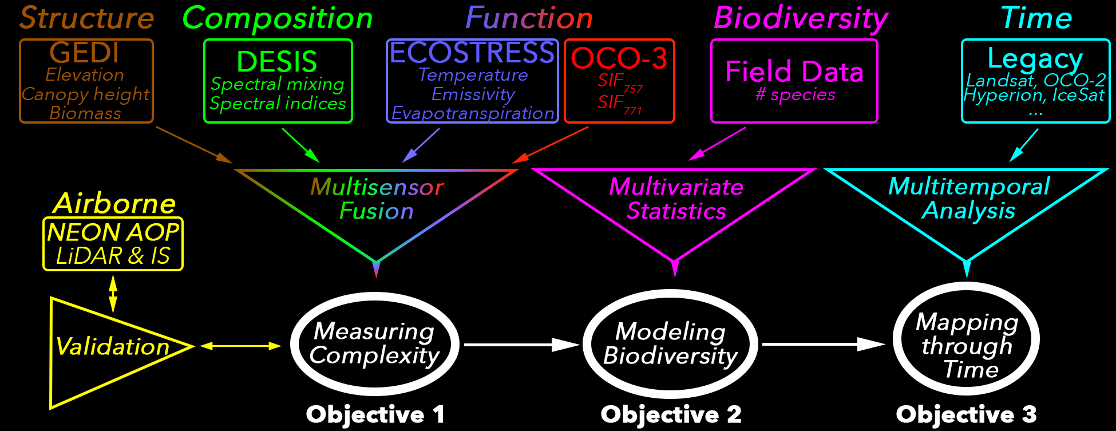
Methodology
Formulation, theory or experiment description
Innovation, advancement

Slide 5
Results
Accomplishments versus goals
Significance
Next steps

Slide 6
Publications and Acknowledgements
Thank you for your time!

