Slide 1
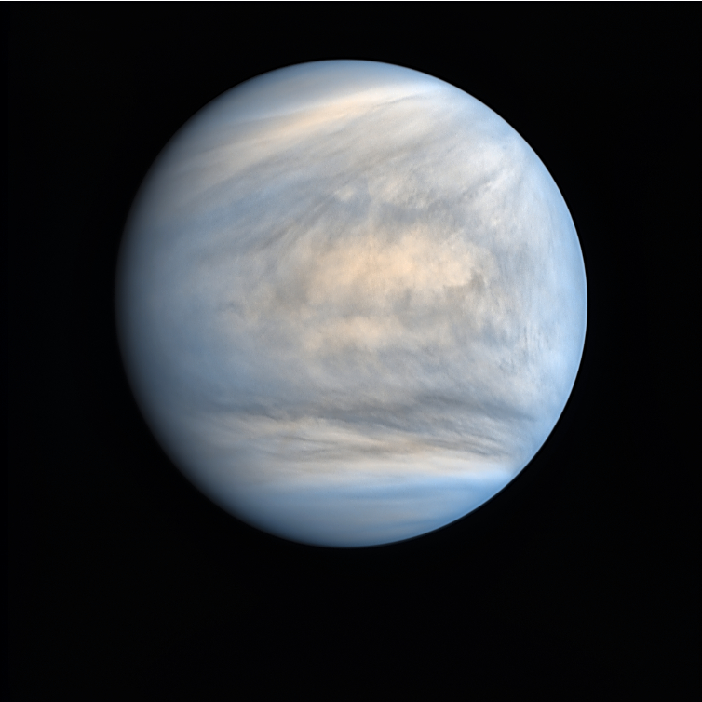
Radio-holographic methods for inversion of radio occultation experiments on Venus
2020 Postdoc Research Day Presentation Conference
Tatiana Bocanegra-Bahamon
Organization: 335G
Advisor: Chi Ao (335G)
Postdoc Program: NPP

Slide 2
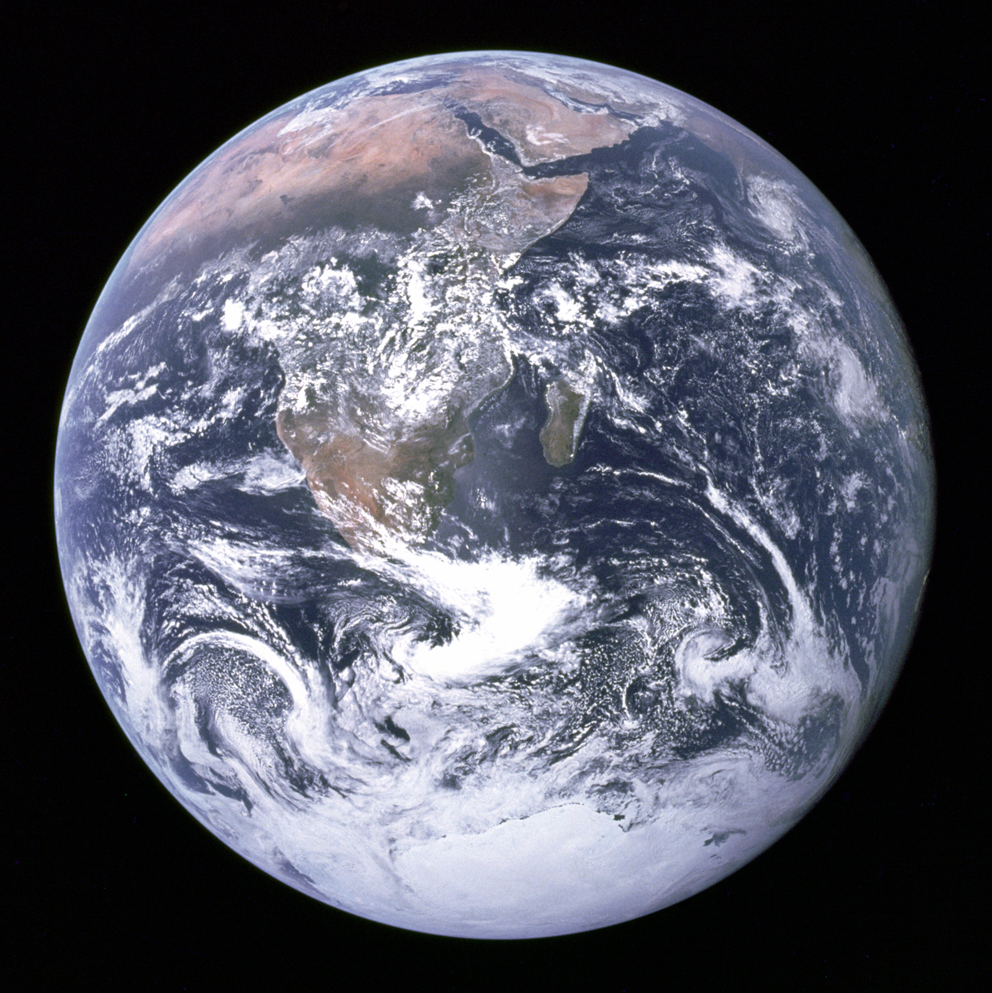
Why study Venus’ atmosphere?
Earth & Venus
Located at similar distances from the Sun.
Similar sizes and bulk composition.
The most massive of the terrestrial planets.
However,
Earth’s “twin” planet took a very different evolutionary paths.
Earth image by NASA/Apollo 17 crew
Venus image by Damia Bouic from JAXA/Akatsuki’s UVI camera

Slide 3
Why study Venus’ atmosphere?
To understand the mechanism that drives the runaway greenhouse effect on Venus it is necessary to:
Determine the radiative and dynamical energy balance of the atmosphere.
Characterize the clouds dynamics and chemistry, and identify their role in Venus’ climate.
Understand the vertical coupling of the atmosphere and surface interaction.

Slide 4
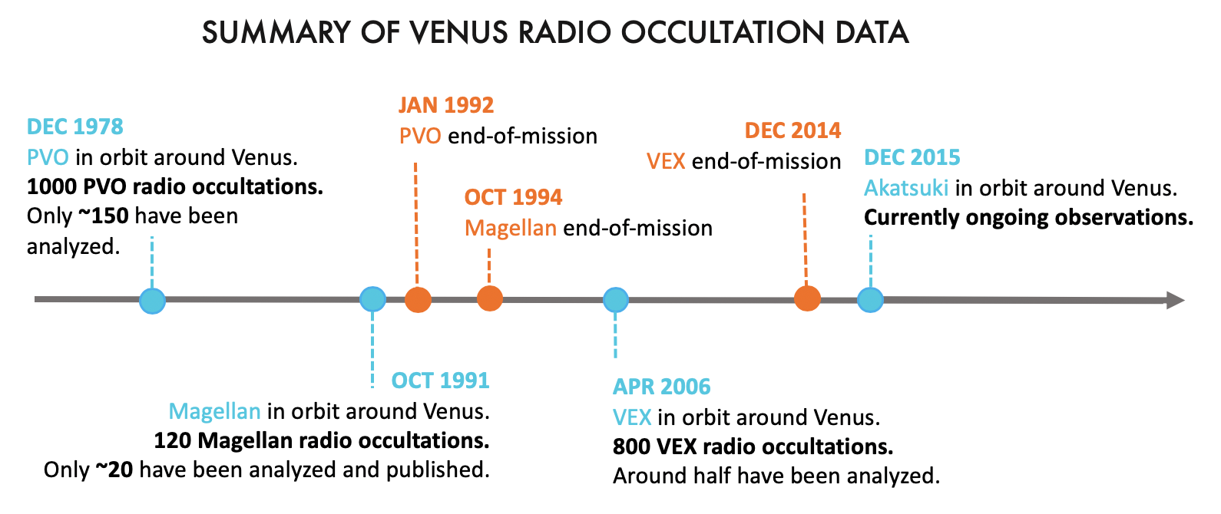
Objective:
Provide atmospheric temperature profiles with high vertical resolution, wide spatial and temporal coverage.
Determine the abundance, global distribution and long-term variability of sulfuric acid in the clouds of Venus.
Method:
Data:
Analysis of radio occultation signals with radio holographic methods.

Slide 5
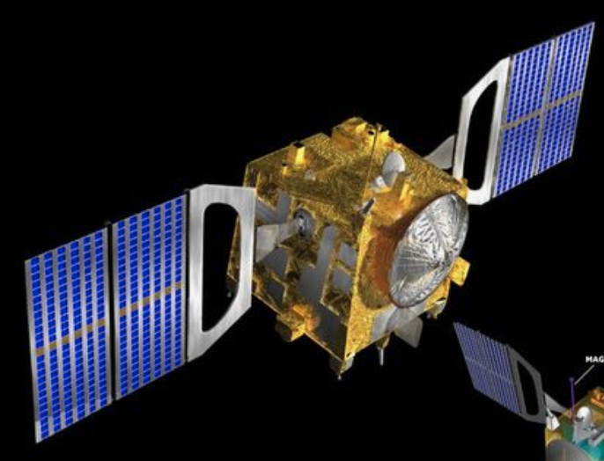
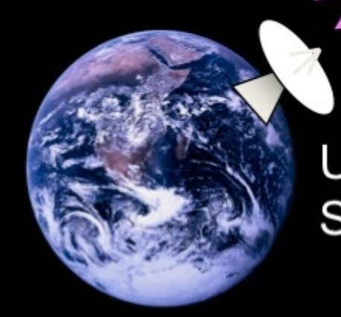
Method: Planetary radio occultation technique
Method: Planetary radio occultation technique
spacecraft motion
The spacecraft carrier signal experiences refraction and absorption as the planet ‘occults’ the spacecraft, due to the propagation of the signal through the planet’s atmosphere on its way to the receiving ground station.
solid planet

Slide 6
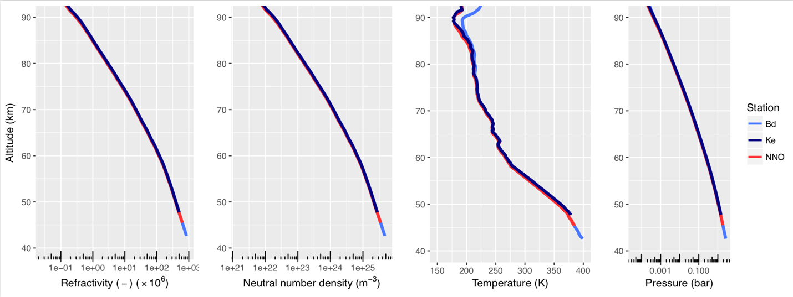
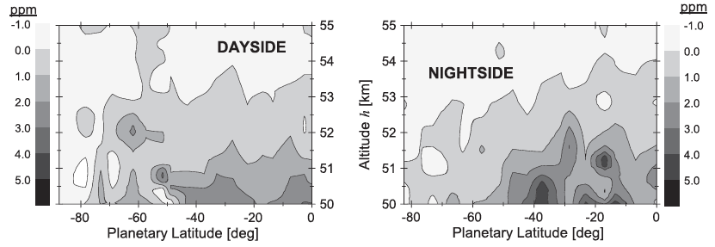
Method: Planetary radio occultation technique
Radio occultation is the remote sensing technique that can probe the lowest altitudes in thick planetary atmospheres at very high vertical resolution.
Deliverables:
Atmospheric temperature, pressure and density profiles.
Ionospheric electron densities.
Sulfuric acid vapor abundances (in the case of Venus).
Atmospheric density, temperature and pressure profiles derived from Venus Express radio occultation data (Bocanegra-Bahamon et al., 2019).
Sulfuric acid vapor abundances derived from Venus Express radio occultation data by the VeRa team (Oschlisnoik et al., 2012).

Slide 7
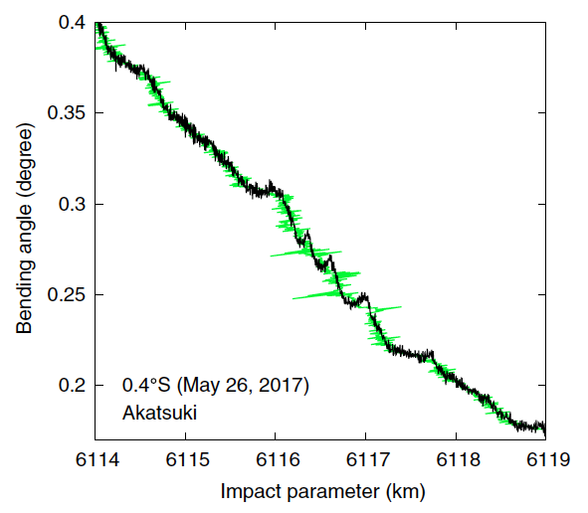
Methodology: Using radio holographic methods to analyze the complex radio occultation signal.
Advantages of radio-holographic methods in comparison to traditional (geometric optics) methods :
Untangles atmospheric multi-path interference.
Unravels the refractive defocusing effects.
Provides higher (sub-Fresnel) vertical resolution (approx. 150 m at X-band).
Example of application of radio-holographic methods for radio occultation data of Akatsuki (Imamura et al., 2018).

Slide 8
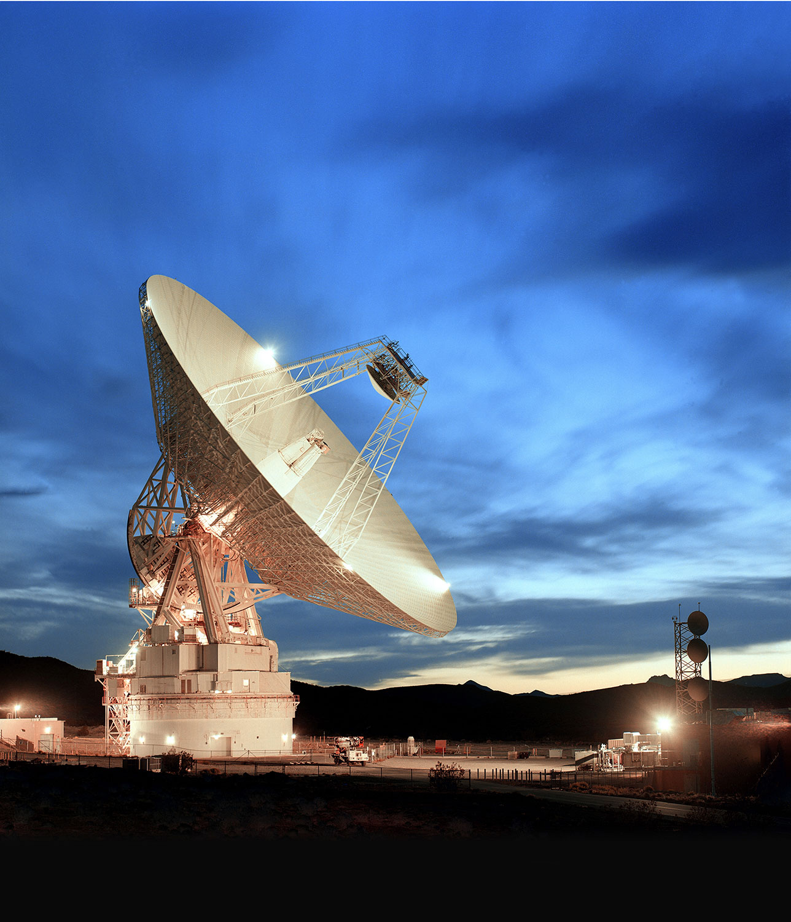
Map the sulfuric acid vapor abundance of the clouds of Venus, with its spatial and temporal variability over 4 solar cycles using radio-holographic methods.
Provide observational constraints to improve our understanding of the chemical schemes that govern Venus’ neutral atmosphere and the evolution of its climate.
The atmospheric profiles will be included in the ongoing efforts of updating the Venus International Reference Atmospheric (VIRA) model, to be used as input for Venus Global Circulation Models (GCMs).
The previously unprocessed radio occultation datasets will be available to the scientific community.
Relevance and impact

