Slide 1

Acousto-optic Modulators in Integrated Photonics
Eric Kittlaus | PRD 2020
Organization: 3890
Advisor: Dr. Siamak Forouhar (3890)
Postdoc Program: JPL
Notes:
Thanks for viewing my virtual poster! Please watch in presentation mode to hear audio narration of the slides. If you have any questions after watching, feel free to email me at eric.kittlaus@jpl.nasa.gov.

Slide 2




Introduction
Light-sound coupling: Traveling hypersound waves change the local density and refractive index of a solid medium, permitting interactions with incident light waves.
Abstract
Light-sound interactions promise new capabilities for applications ranging from high-fidelity optical and microwave signal processing to quantum state control. However, many existing “acousto-optic” devices use non-standard materials and fabrication schemes that are incompatible with standard chip-based integrated photonic circuits.
In this work, we demonstrate the first practical acousto-optic devices in integrated silicon photonics. Our platform harnesses microfabricated surface acoustic wave transducers operating at GHz frequencies to control the behavior of light in nanoscale silicon optical waveguides, enabling an array of operations including optical frequency-shifting, amplitude- and phase-modulation, and non-reciprocal signal routing.
These new chip-based devices offer transformative improvements in size and power consumption as compared to conventional bulk acousto-optic devices, through an approach that is compatible with standard foundry fabrication and with existing silicon photonic device technologies. At the same time, our integrated platform enables new functionalities based on wavelength-scale geometric control. By bridging optical, mechanical, and electrical degrees of freedom, these high-performance acousto-optic modulators will enhance future instruments for optical sensing and spectroscopy, lidar, microwave signal generation, and optical communications.
Incident light
Light is Bragg-reflected and Doppler-shifted by a travelling elastic wave
Reflected light
Sound wave
Diagram of a typical acousto-optic modulator: An incident electrical (RF) signal drives an elastic wave in a piezoelectric crystal. Light diffracts and frequency-shifts off of this acoustic grating. By controlling the input electrical signal, we directly control the output optical waveform.
Crystal
Incident Light
Diffracted Light
$$ω_{l}$$
$ω_{l}+Ω_{RF}$
Elastic wave
$$Ω_{RF}$$
Notes:
Thanks for viewing my virtual poster! Please watch in presentation mode to hear audio narration of the slides. If you have any questions after watching, feel free to email me at eric.kittlaus@jpl.nasa.gov.

Slide 3
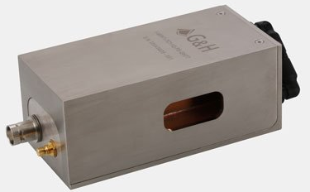
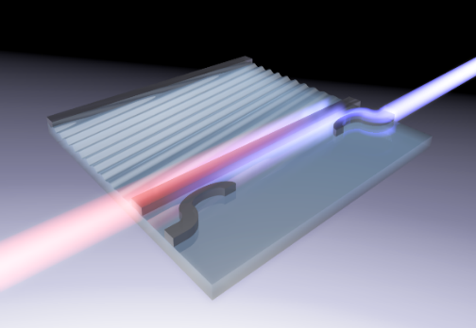
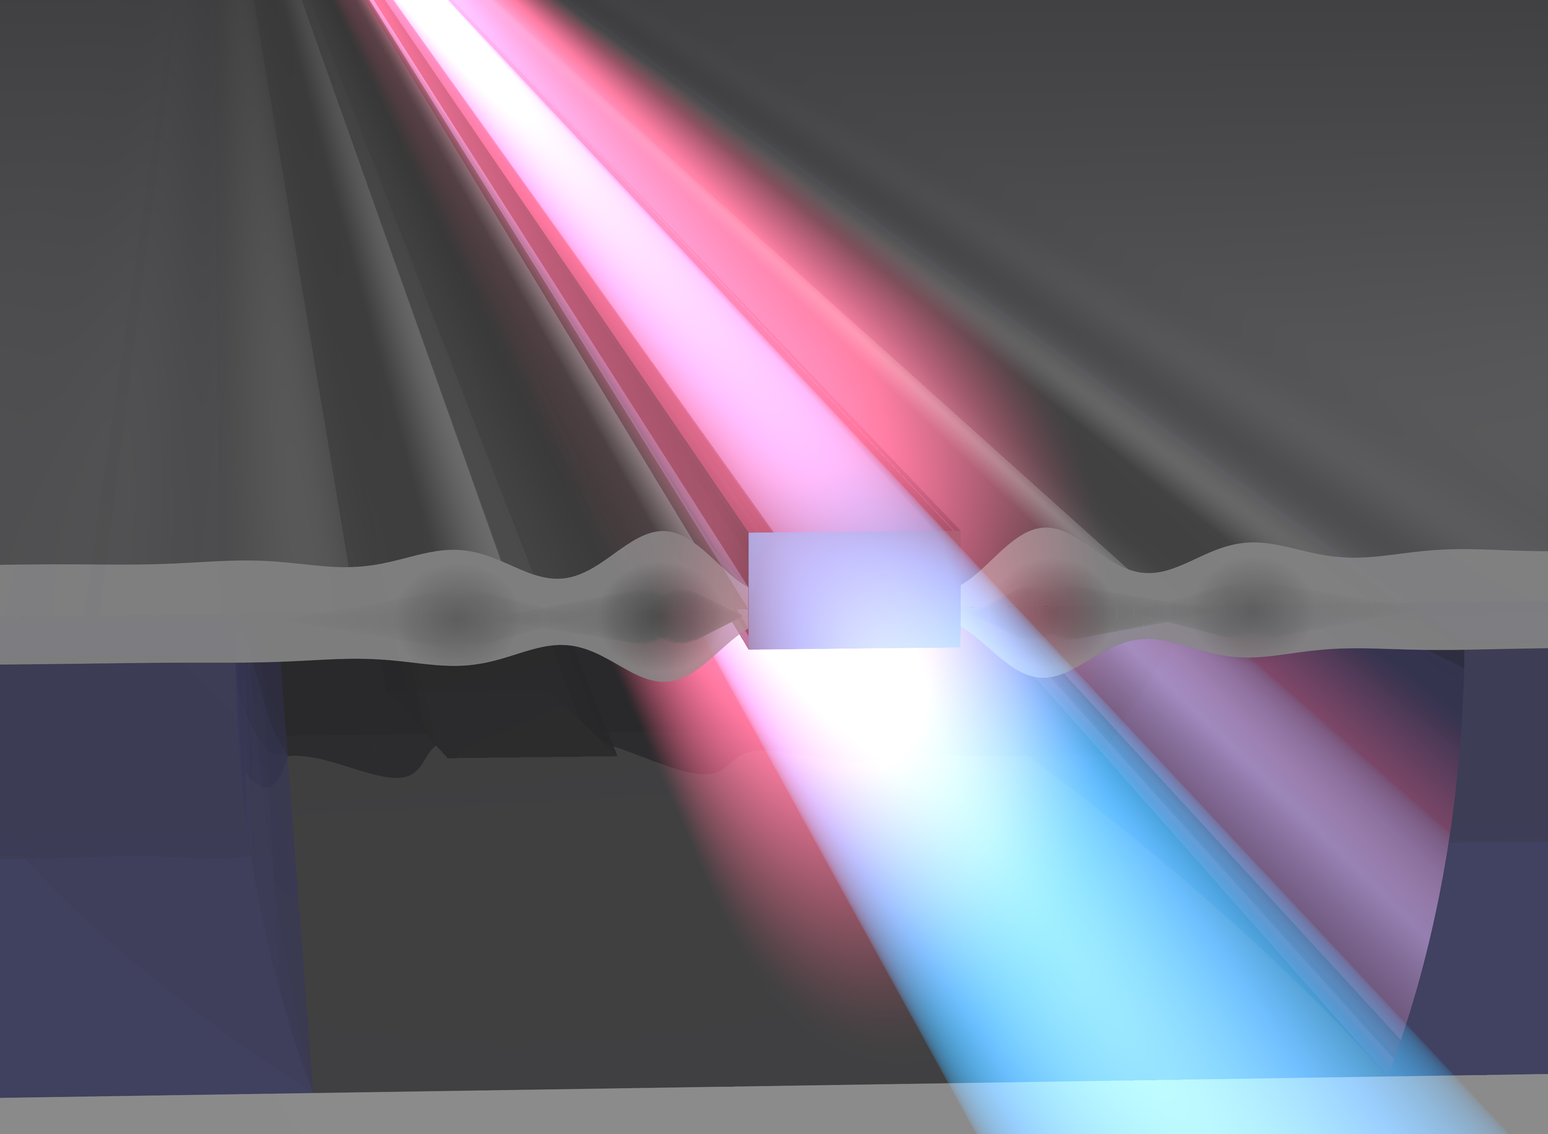
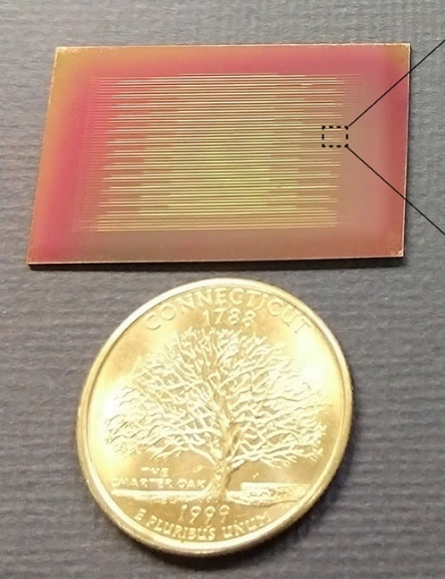
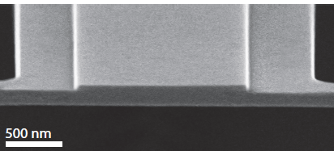


Goal: Use hypersound to control the behavior of light on the surface of a photonic chip
Problem Description
Context:
Bulk Acousto-optic modulator
Integrated Acousto-optic device
Acousto-optic devices are widely used for:
Frequency and amplitude control of light waves
Beam-steering and pulse picking
Signal processing and lock-in detection
So far, acousto-optics has remained relatively unexplored in chip-based photonic circuits. Our goal is to develop practical acousto-optic devices in silicon photonics—the leading platform for integrated optics.
Gooch & Housego
Volume $≈$ 5 in³, Power $≈$ 0.5 W
Volume $≈$ 1 mm³, Power $≈$ 0.001 W
New functionalities!
My prior work: optomechanics in silicon membrane waveguides
Why this topic interests me:
I have previously worked on the development of chip-based signal processing using optically-driven acoustic waves. However, to produce acoustic waves using nonlinear optics is extremely inefficient and costly, so I wanted to find a way to harness these types of interactions with direct electrical driving. One goal of my Postdoctoral appointment at JPL’s Microdevices Laboratory (MDL) was to leverage the MDL’s processing capabilities to develop a new chip-scale platform for electrically-controlled acousto-optic devices.
Silicon chip
Light-sound coupling
Applications:
Optical Amplification:
Nat. Photonics 10, 463 (2016);
Nat. Commun. 8, 15819 (2017); Science 360, 1113 (2018).
RF Filtering:
JLT 36, 2803 (2018).
Non-reciprocal optics:
Nat. Photonics 12, 613 (2018);
Optica 6, 1117 (2019).
Optomechanical waveguide
Notes:
Thanks for viewing my virtual poster! Please watch in presentation mode to hear audio narration of the slides. If you have any questions after watching, feel free to email me at eric.kittlaus@jpl.nasa.gov.

Slide 4
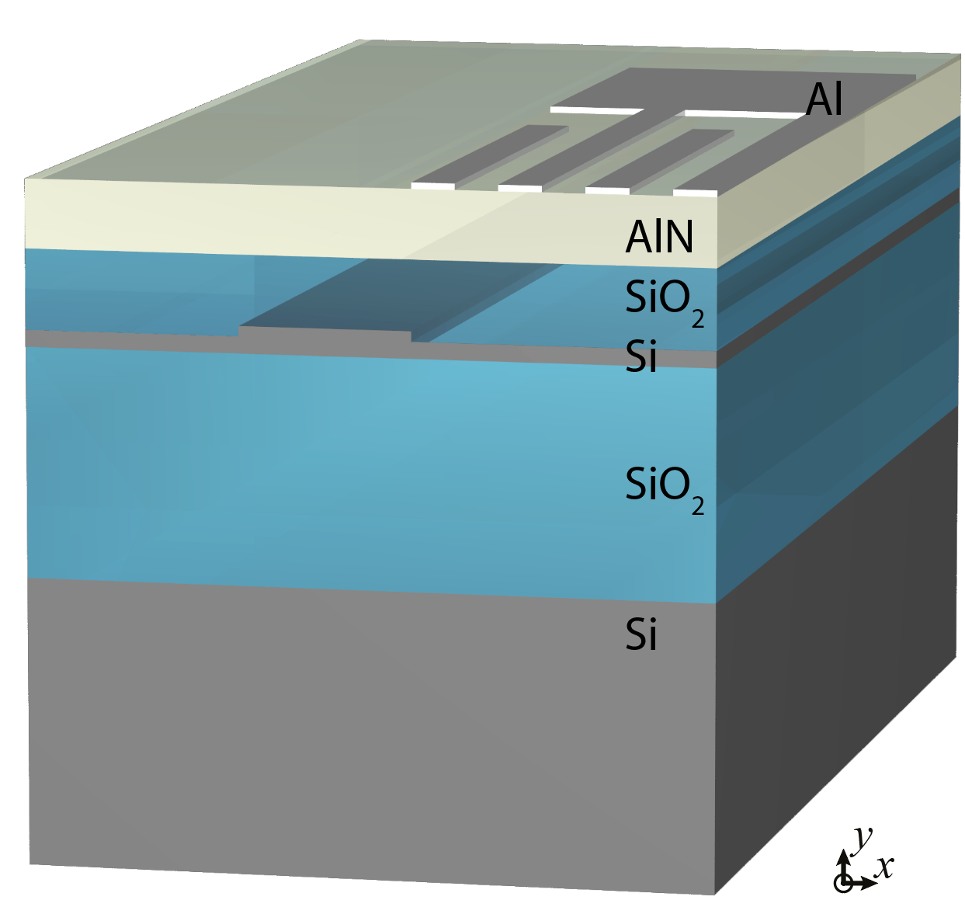
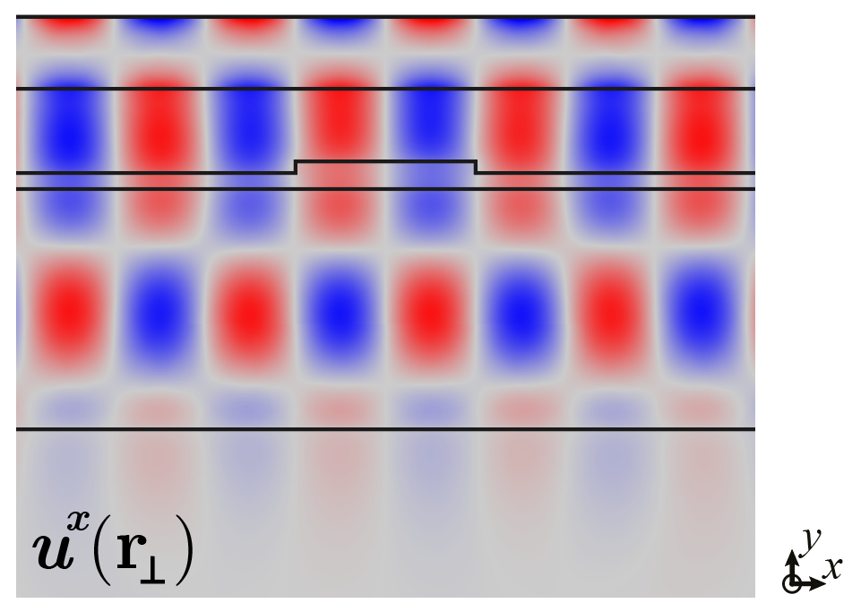
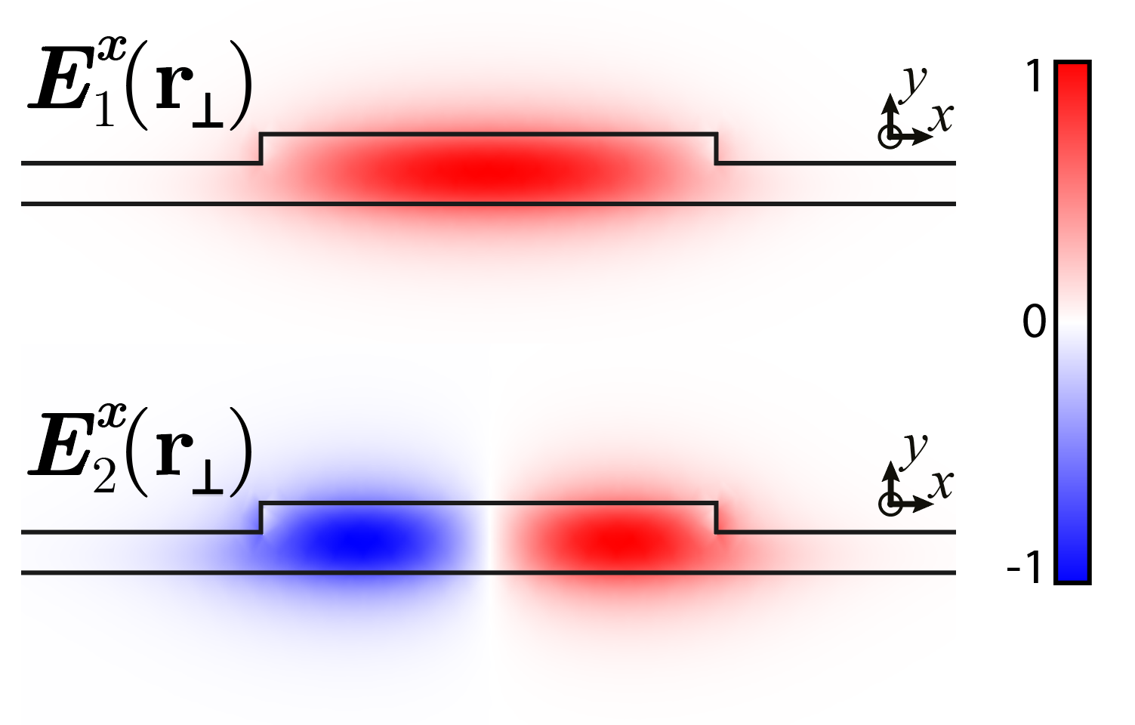
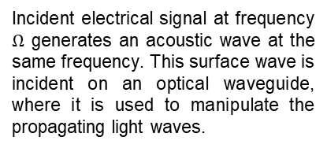
Methodology
Innovation: A new platform for integrated piezo-optics
Polycrystalline AlN
Sputter-deposited through a CMOS-compatible process
Enables strong piezoelectric transduction of acoustic waves
Inter-digitated transducer (IDT)
Inter-digitated aluminum electrodes drive surface acoustic waves (SAWs)
Excited SAWs extend throughout device region so they can modulate guided light
Silicon device layer
Optical waves are guided in a silicon ridge waveguide that acts as a “photonic wire”
Other types of photonic devices can be simultaneously fabricated in the same layer
Goal: combine optical and acoustic components on a single chip
Device concept
IDT
Silicon Waveguide
Acoustic Mode
Optical Modes
Incident electrical signal at frequency $Ω$ generates an acoustic wave at the same frequency. This surface wave is incident on an optical waveguide, where it is used to manipulate the propagating light waves.
Result: Acousto-optic interactions realized on-chip using a standard semiconductor fabrication process
Notes:
Thanks for viewing my virtual poster! Please watch in presentation mode to hear audio narration of the slides. If you have any questions after watching, feel free to email me at eric.kittlaus@jpl.nasa.gov.

Slide 5
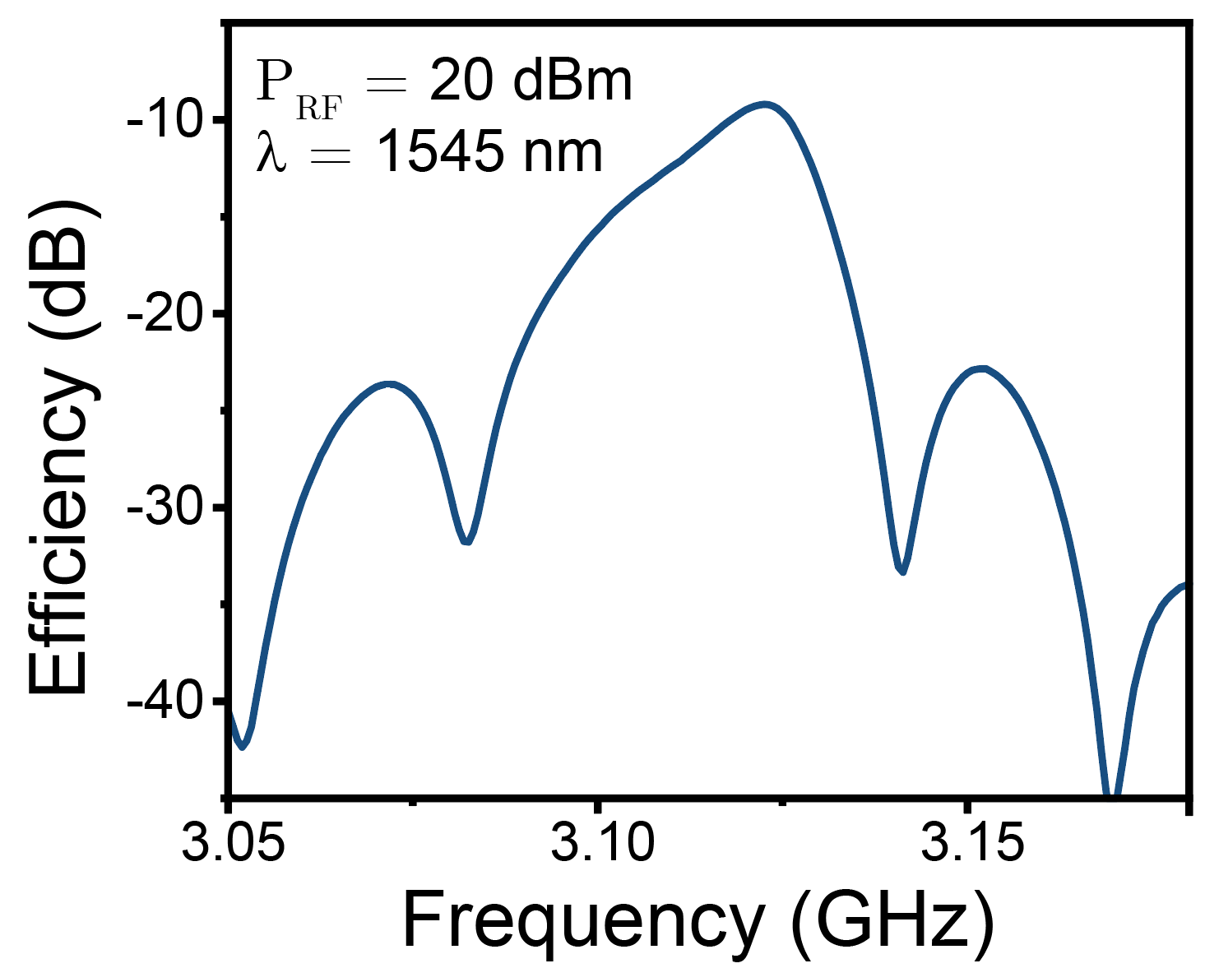
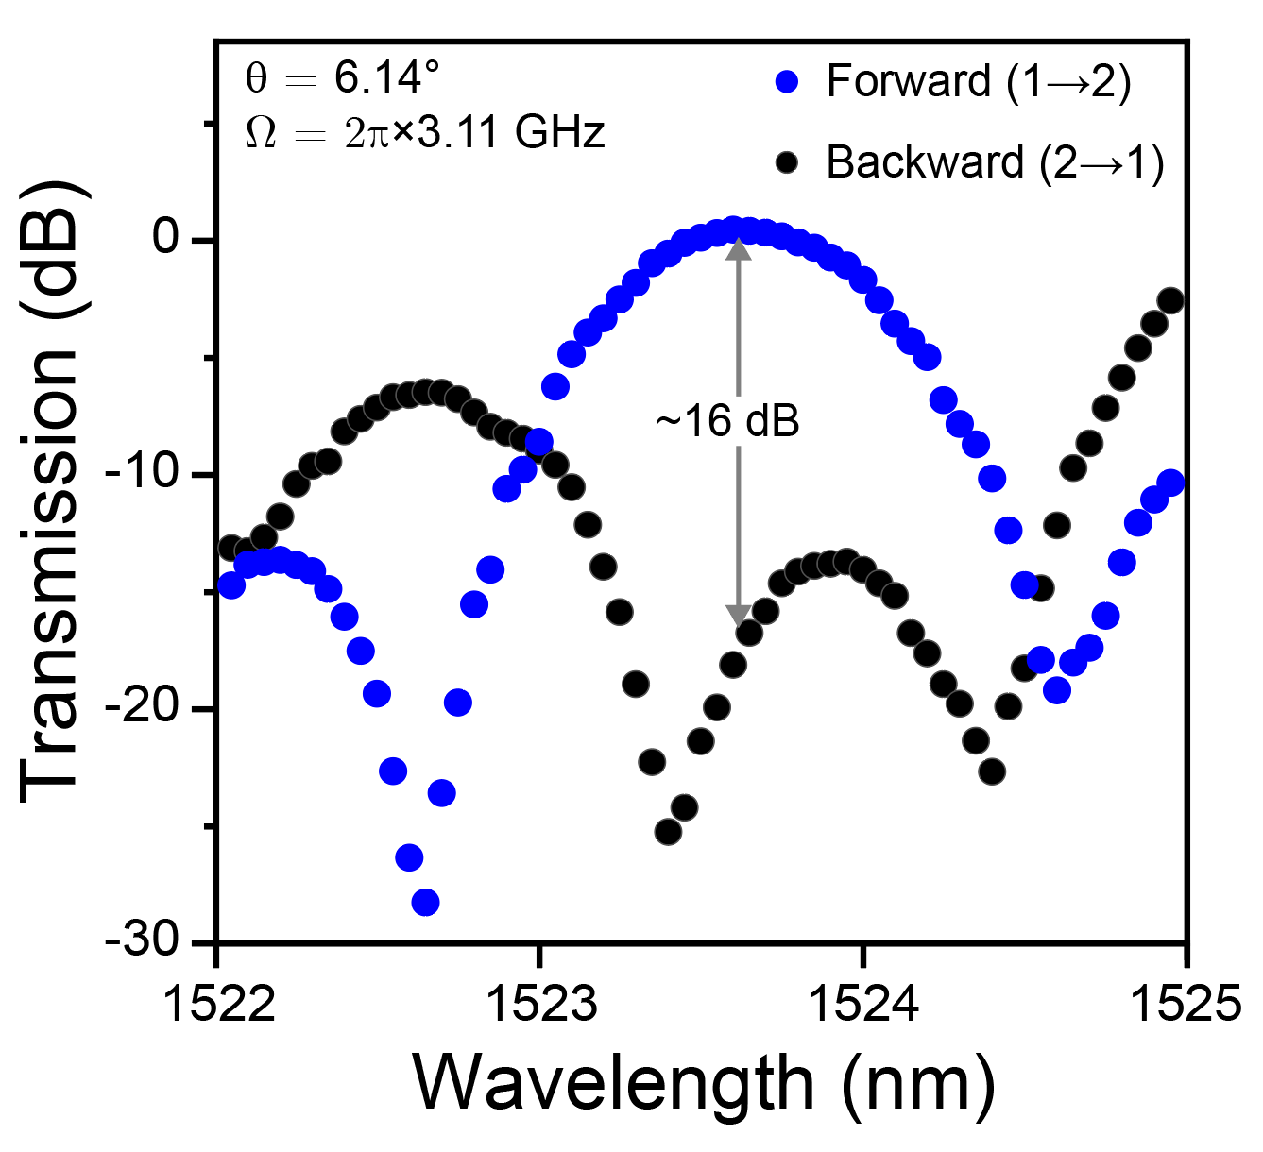
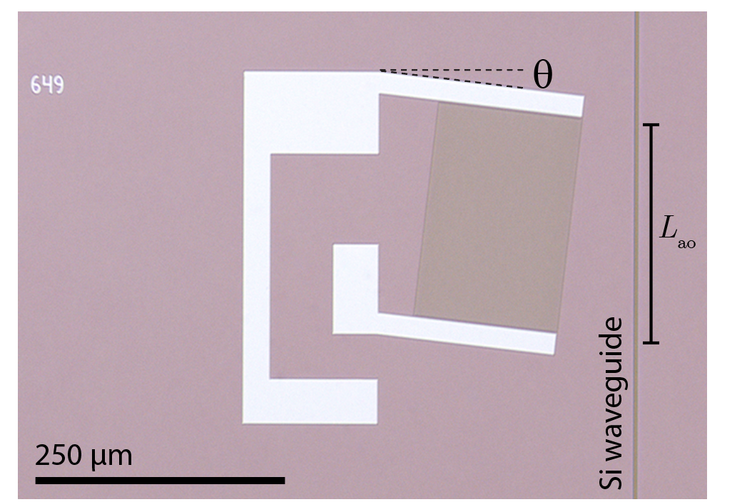
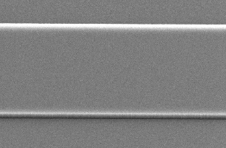
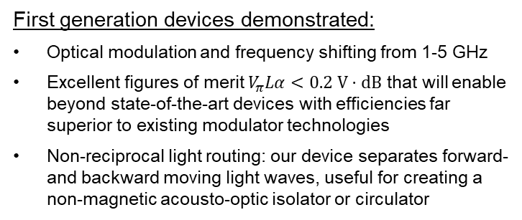
Results
Chip-based devices fabricated at JPL’s Microdevices Laboratory
GHz-frequency Modulation
Non-reciprocal light control
SAW transducer
1 μm
Low-loss (~0.1 dB/cm) silicon waveguide
Monolithic fabrication of acousto-optic devices using a CMOS-compatible process
Electrical contacts
Precise electrical frequency control of output light
Light is transmitted only in one direction: “optical isolator”
Applications
First generation devices demonstrated:
Optical modulation and frequency shifting from 1-5 GHz
Excellent figures of merit $V_{π}Lα<0.2 V⋅dB$ that will enable beyond state-of-the-art devices with efficiencies far superior to existing modulator technologies
Non-reciprocal light routing: our device separates forward- and backward moving light waves, useful for creating a non-magnetic acousto-optic isolator or circulator
Potential applications:
Low-power (~mW) cw lidar modulation for platform-constrained (e.g. satellite-based) remote sensing
Comb generation for spectroscopy, offset-locking, and optical frequency division for mmW, e.g. for gas detection
Active phase sensing and correction for coherent laser metrology and segmented mirror systems
Integrated, nonmagnetic optical isolators/circulators
Notes:
Thanks for viewing my virtual poster! Please watch in presentation mode to hear audio narration of the slides. If you have any questions after watching, feel free to email me at eric.kittlaus@jpl.nasa.gov.

Slide 6
Questions?: eric.kittlaus@jpl.nasa.gov
Publications and Acknowledgements
Journal and Conference Presentations:
Takeaways: Sound waves can be very useful for controlling the behavior of light. To harness this utility, we implemented acousto-optic interactions in chip-based photonic circuits, demonstrating efficient amplitude and frequency control of light, and non-reciprocal routing. This new technology has potential applications in lidar, spectroscopy, and optical signal processing.
E.A. Kittlaus, W.M. Jones, P.T. Rakich, N.T. Otterstrom, R.E. Muller, and M. Rais-Zadeh, "Electrically-driven acousto-optics and broadband non-reciprocity in silicon photonics." Journal Article published at Nature Photonics (2020) doi:10.1038/s41566-020-00711-9.
E.A. Kittlaus, W.M. Jones, P.T. Rakich, N.T. Otterstrom, R.E. Muller, and M. Rais-Zadeh, “Acousto-optic Interactions in Silicon Photonics.” Invited Talk in Symposium S3 at the 2020 Conference on Lasers and Electro-Optics Pacific Rim (CLEO-PR), Sydney, AU, Aug. 4, 2020.
E.A. Kittlaus, W.M. Jones, P.T. Rakich, N.T. Otterstrom, R.E. Muller, and M. Rais-Zadeh, “Electrically-driven Acousto-optic Modulators in Silicon Photonics.” Post-deadline Talk JTh4A.4 at CLEO: Applications and Technology, San Jose, CA, May 20, 2020.
Acknowledgements:
JPL: Max Jones, Rich Muller, Mina Rais-Zadeh, Cliff Frez, Peter Weigel, Lukasz Sterczewski, Siamak Foruhar, Dan Wilson
Yale: Peter Rakich, Nils Otterstrom, Shai Gertler
Michigan: Afzaal Qamar
OEM Group, Inc.: Chao Li, Farid Alokozai, Valeriy Felmetsger
Notes:
Thanks for viewing my virtual poster! Please watch in presentation mode to hear audio narration of the slides. If you have any questions after watching, feel free to email me at eric.kittlaus@jpl.nasa.gov.

